Slide 1
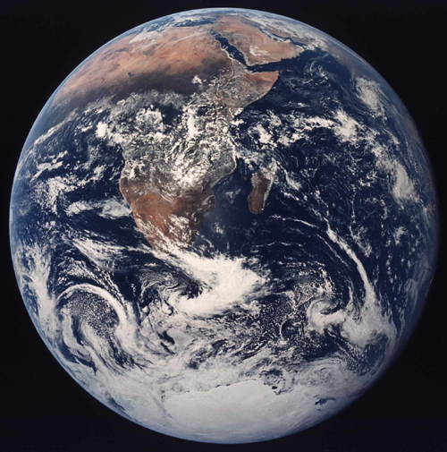
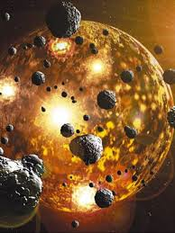
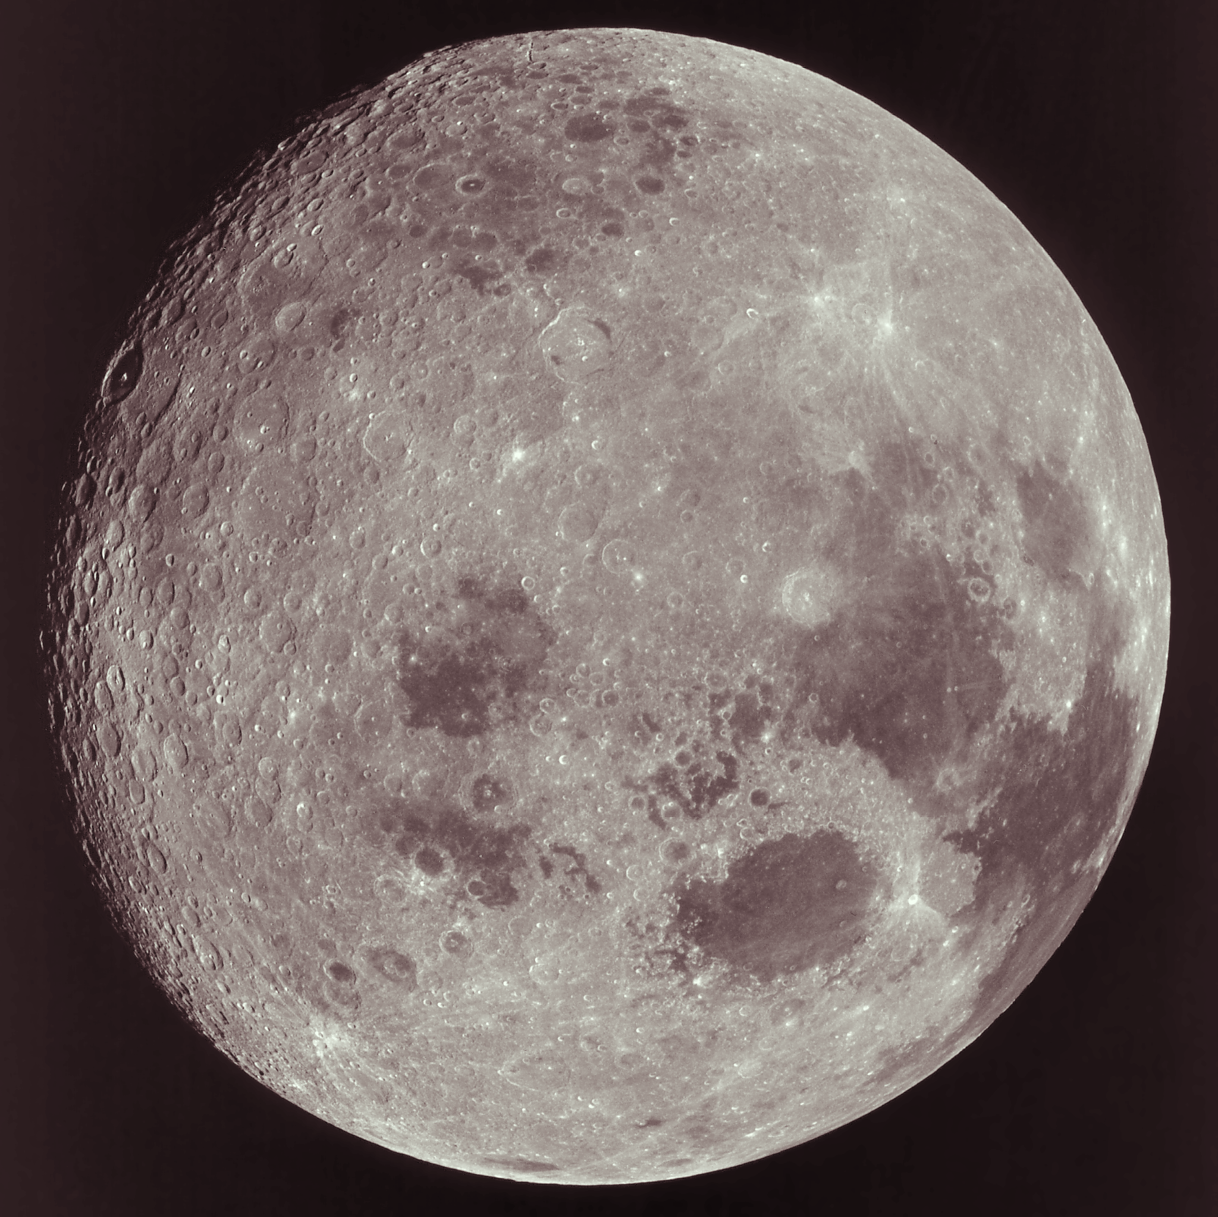
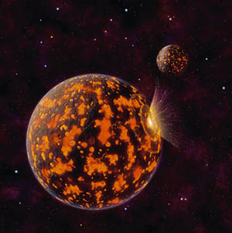
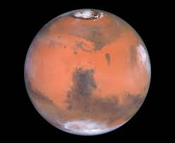
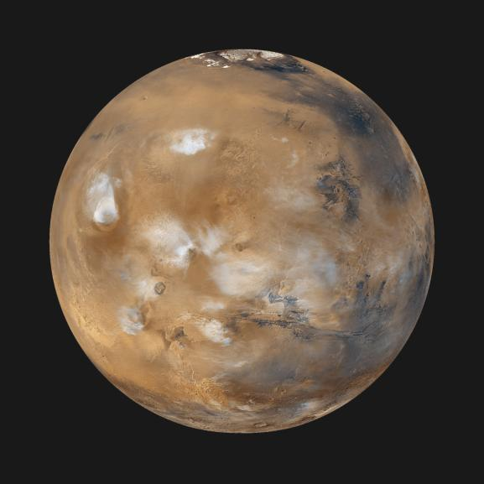
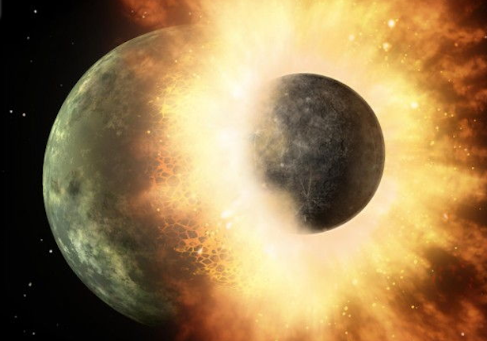



Applying the hard-rock, high-temperature isotope geochemist’s toolkit to SILVER
Janne Blichert-Toft
CNRS & ENS de Lyon
ERC SILVER Kick-Off Meeting, ENS de Lyon, January 21-24, 2018

Slide 2
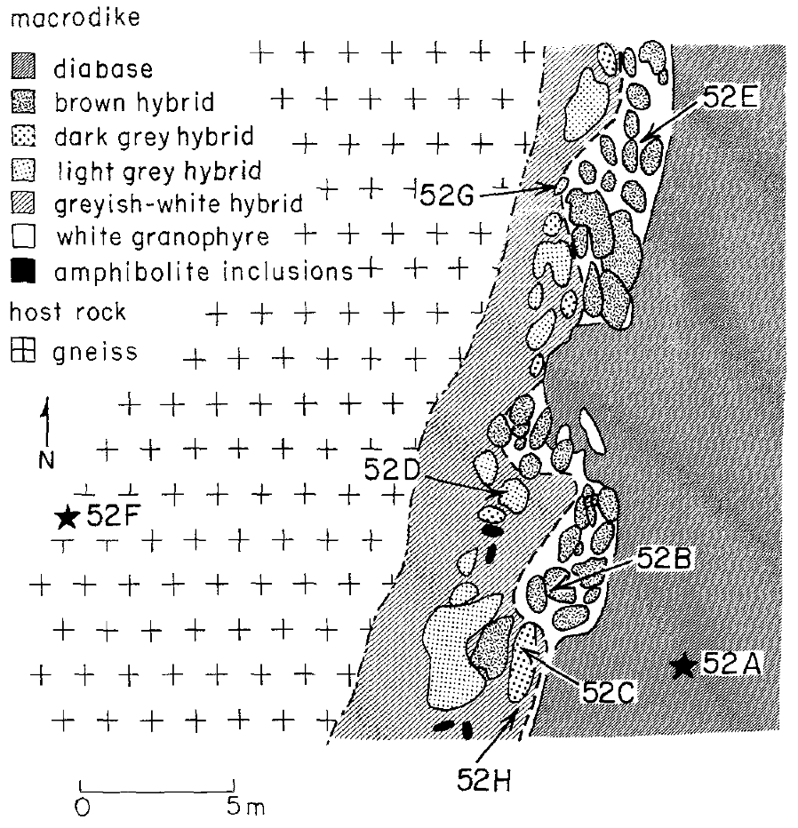
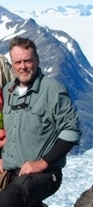
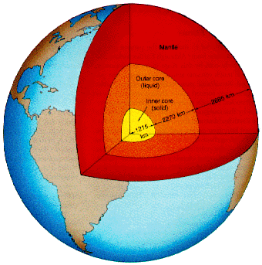
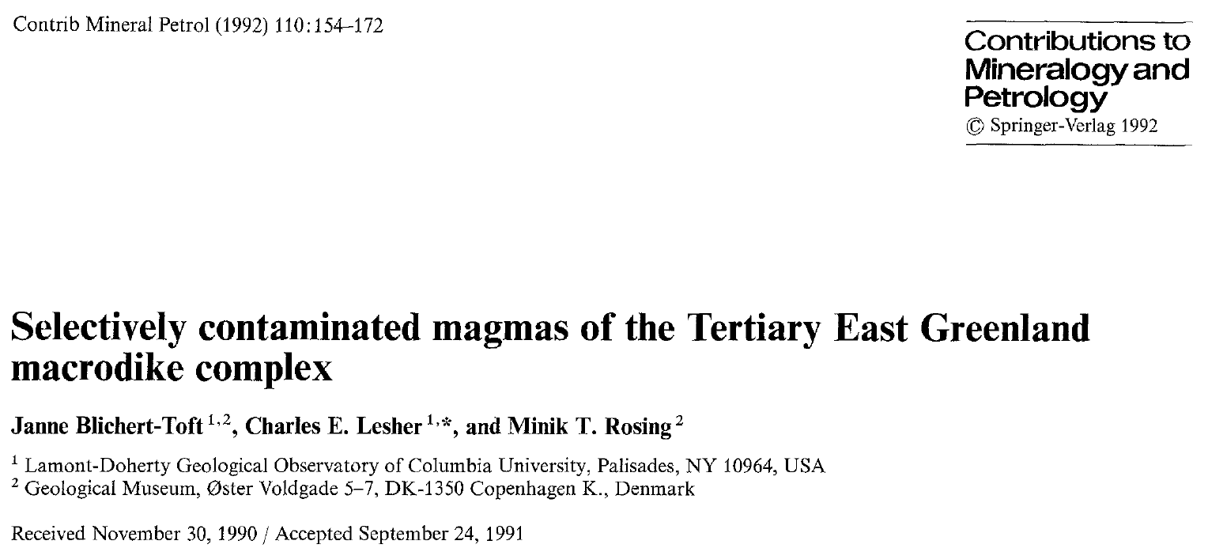
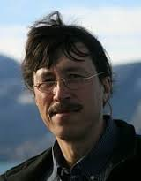
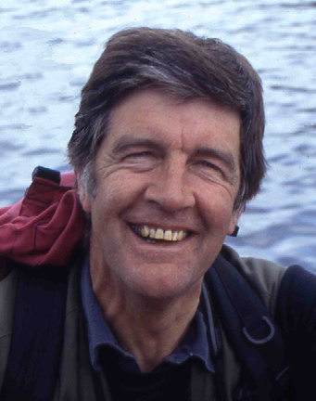
My first step (M.Sc.; 1987-1990)!
East Greenland, Skaergaard, Macrodikes, Earth’s mantle, radiogenic isotopes, TIMS, mantle geochemistry

Slide 3
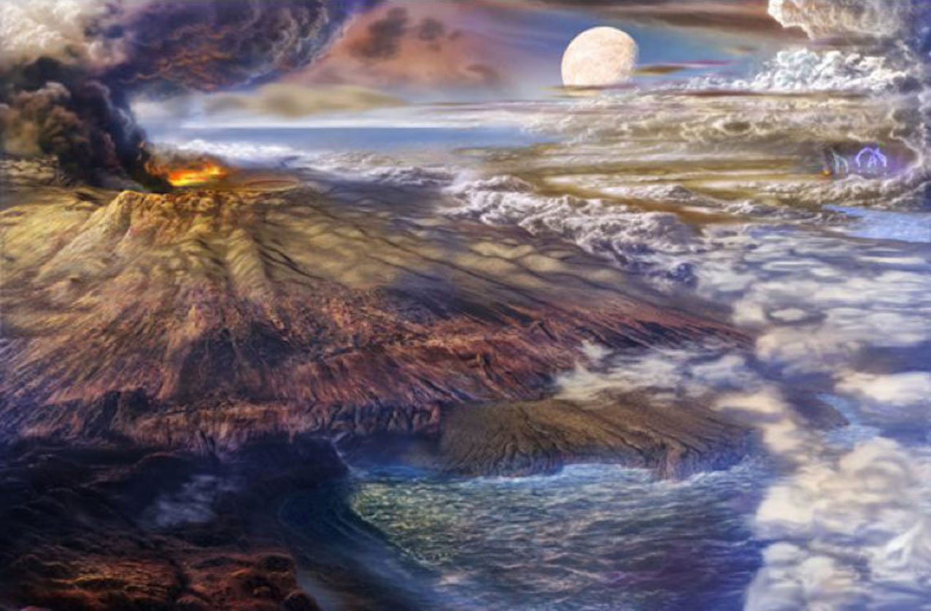
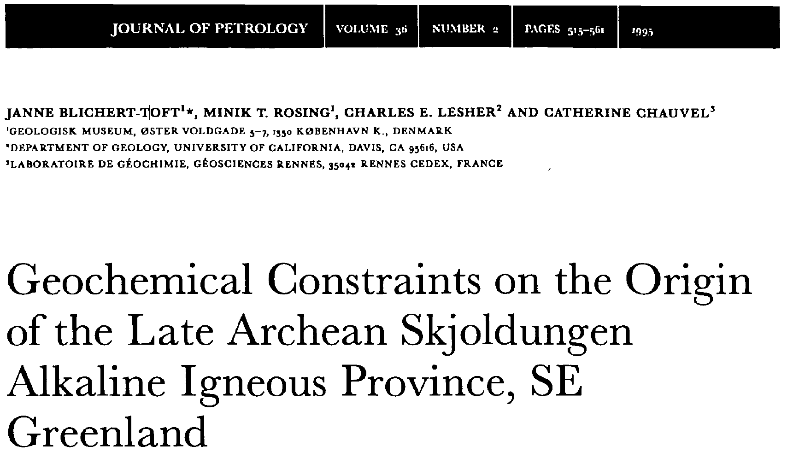

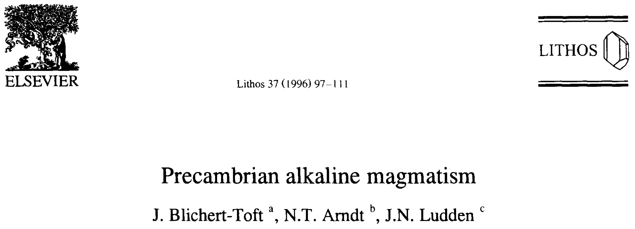
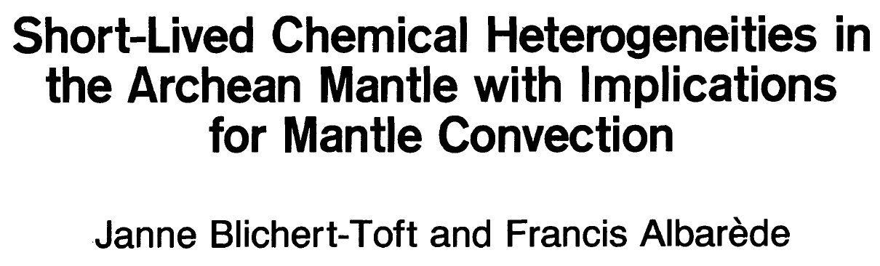
My second step (Ph.D.; 1990-1993)!
Skjoldungen, alkaline magmatism, early Earth, deep time

Slide 4
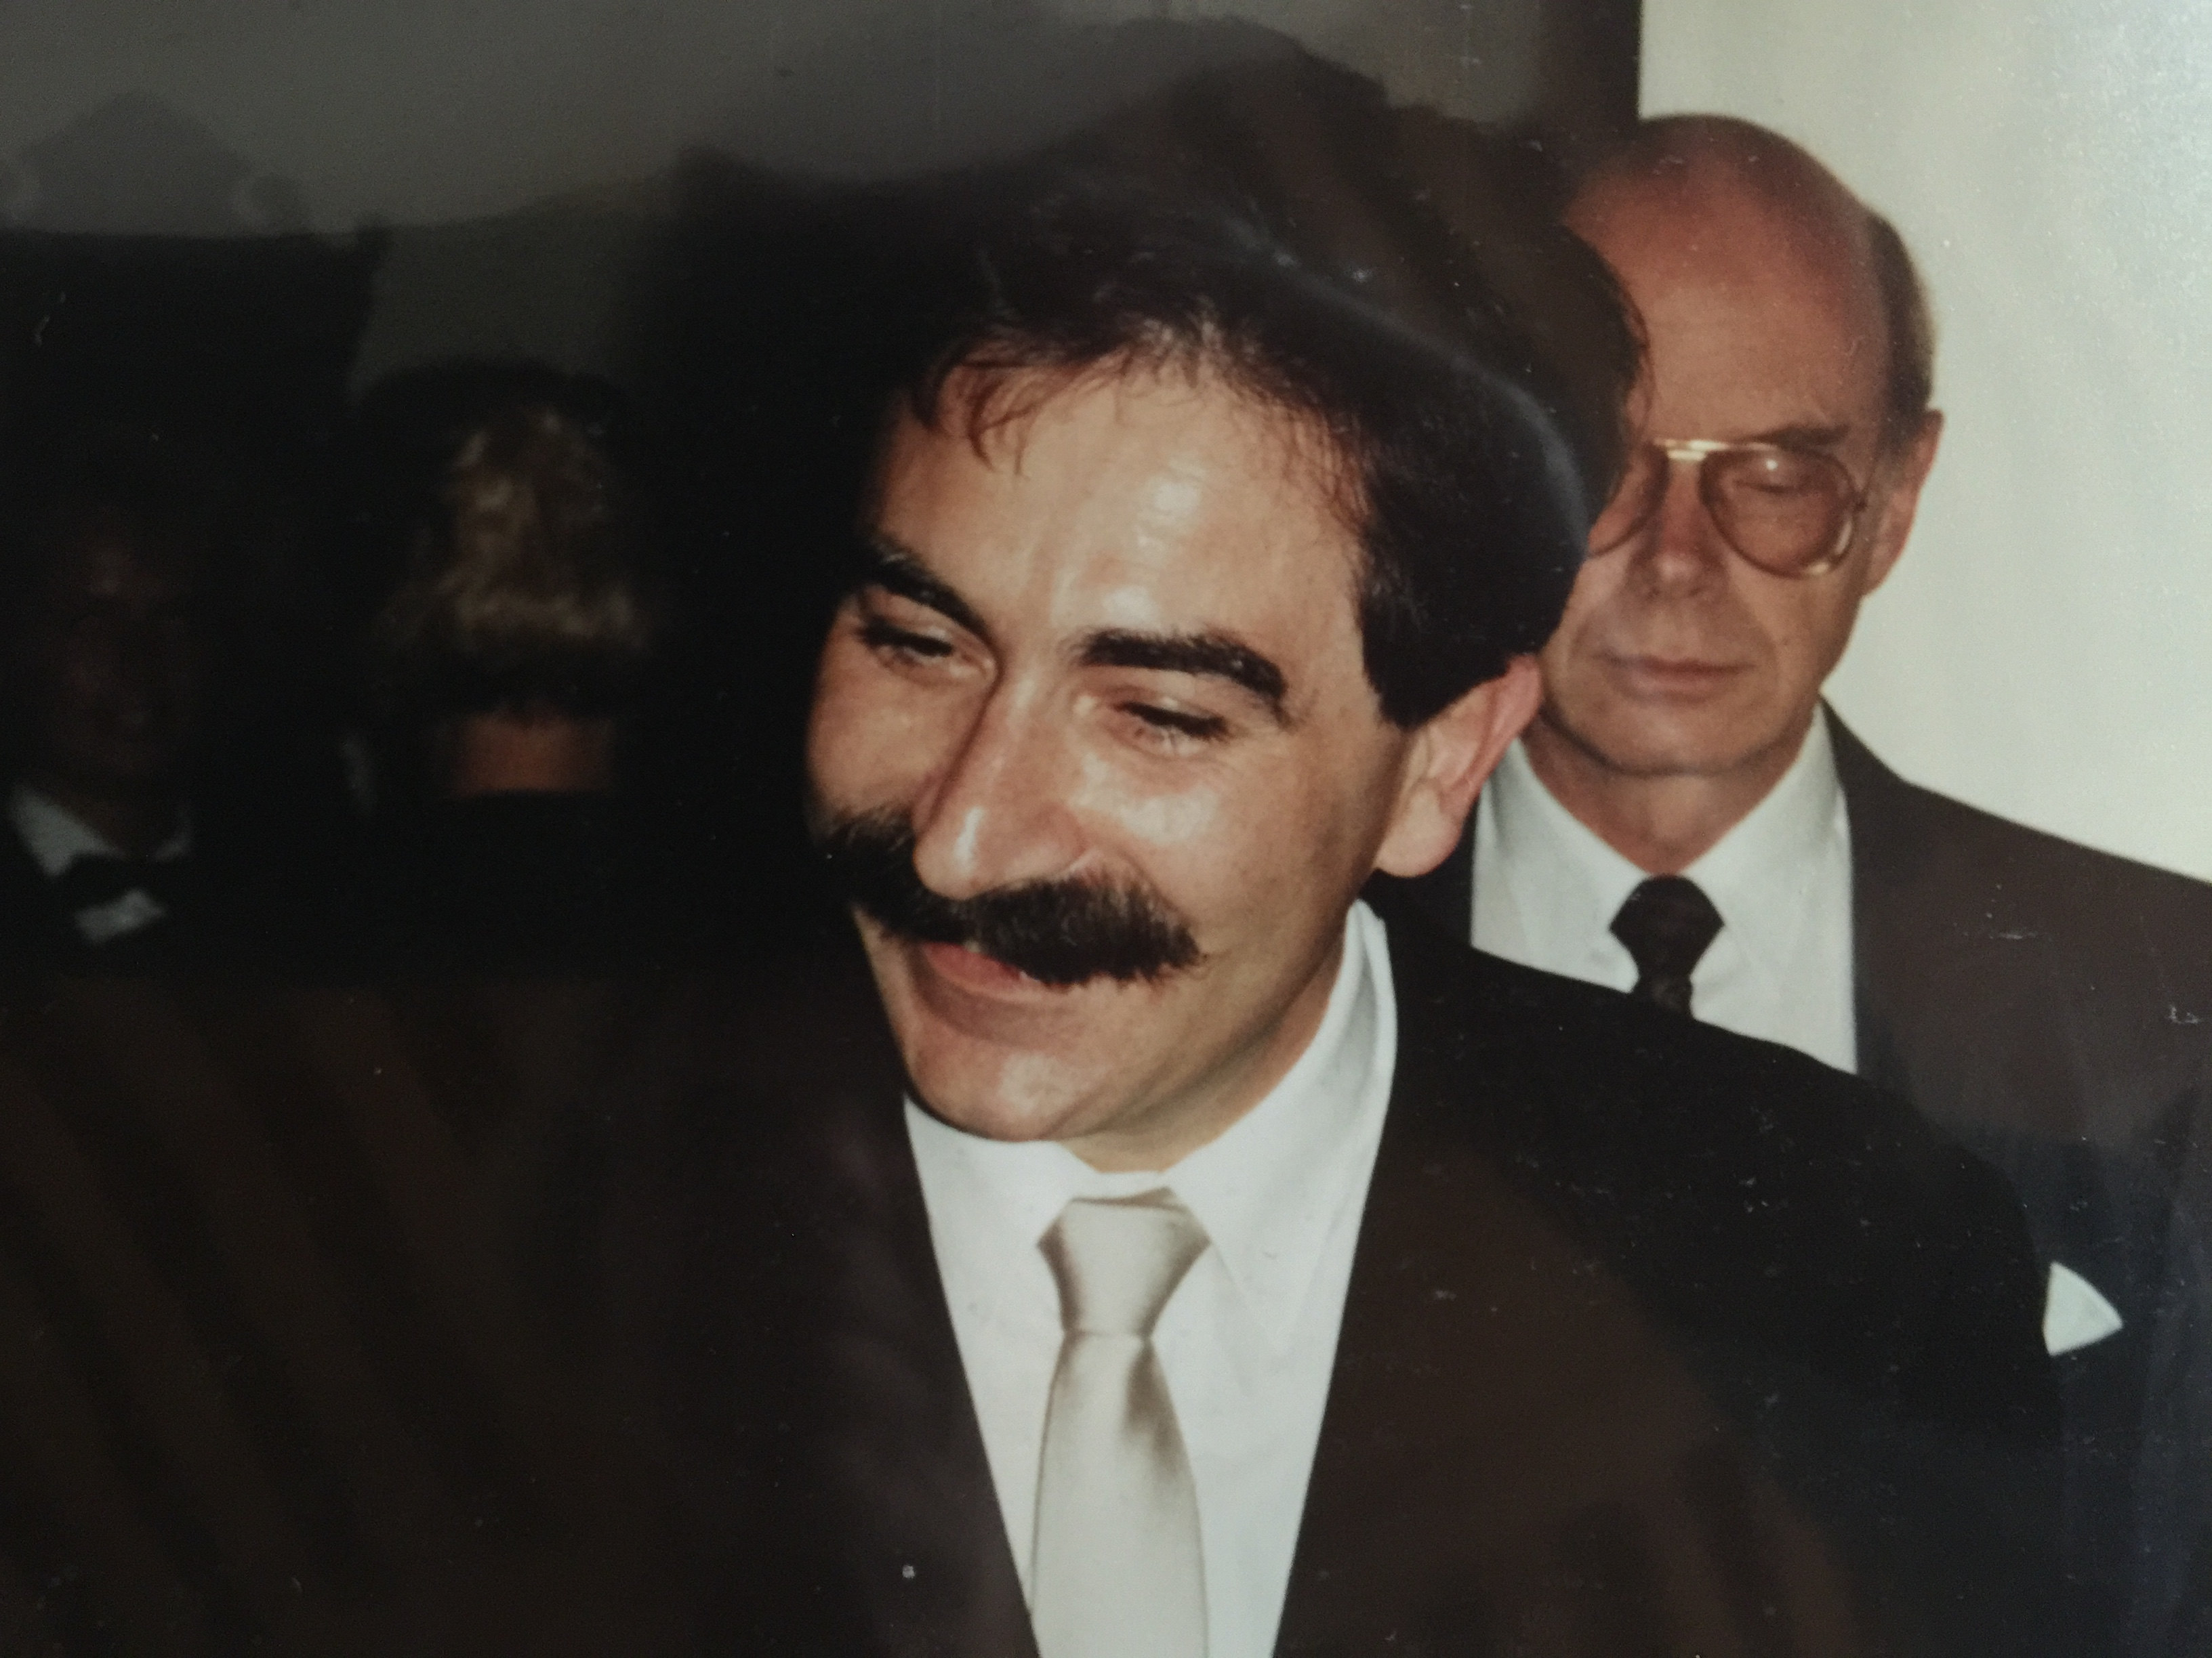
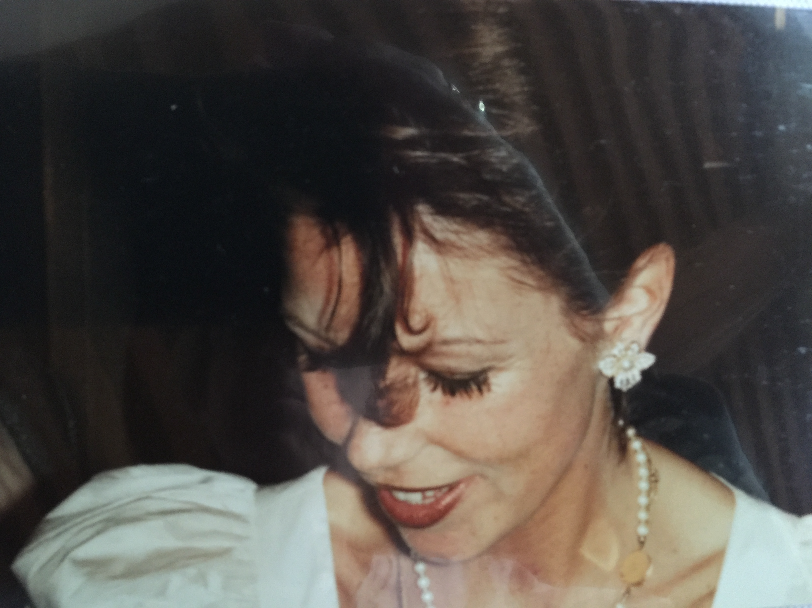
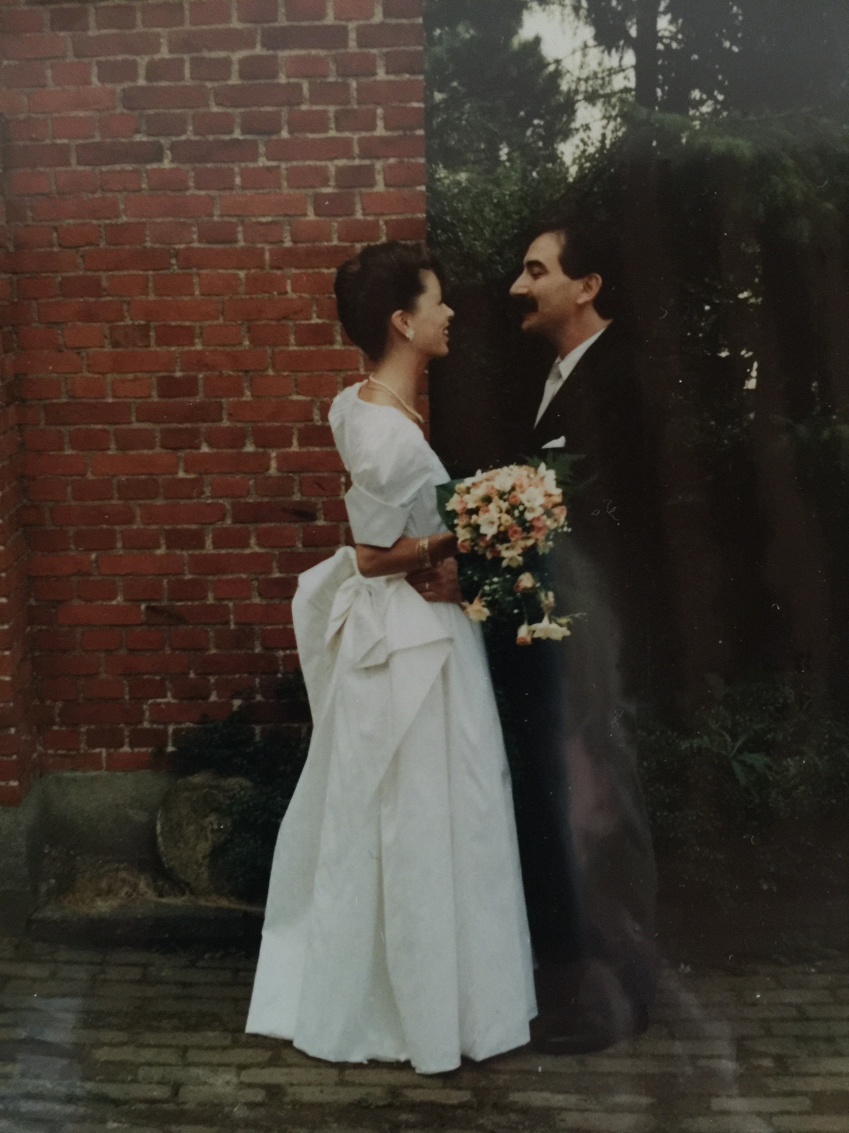
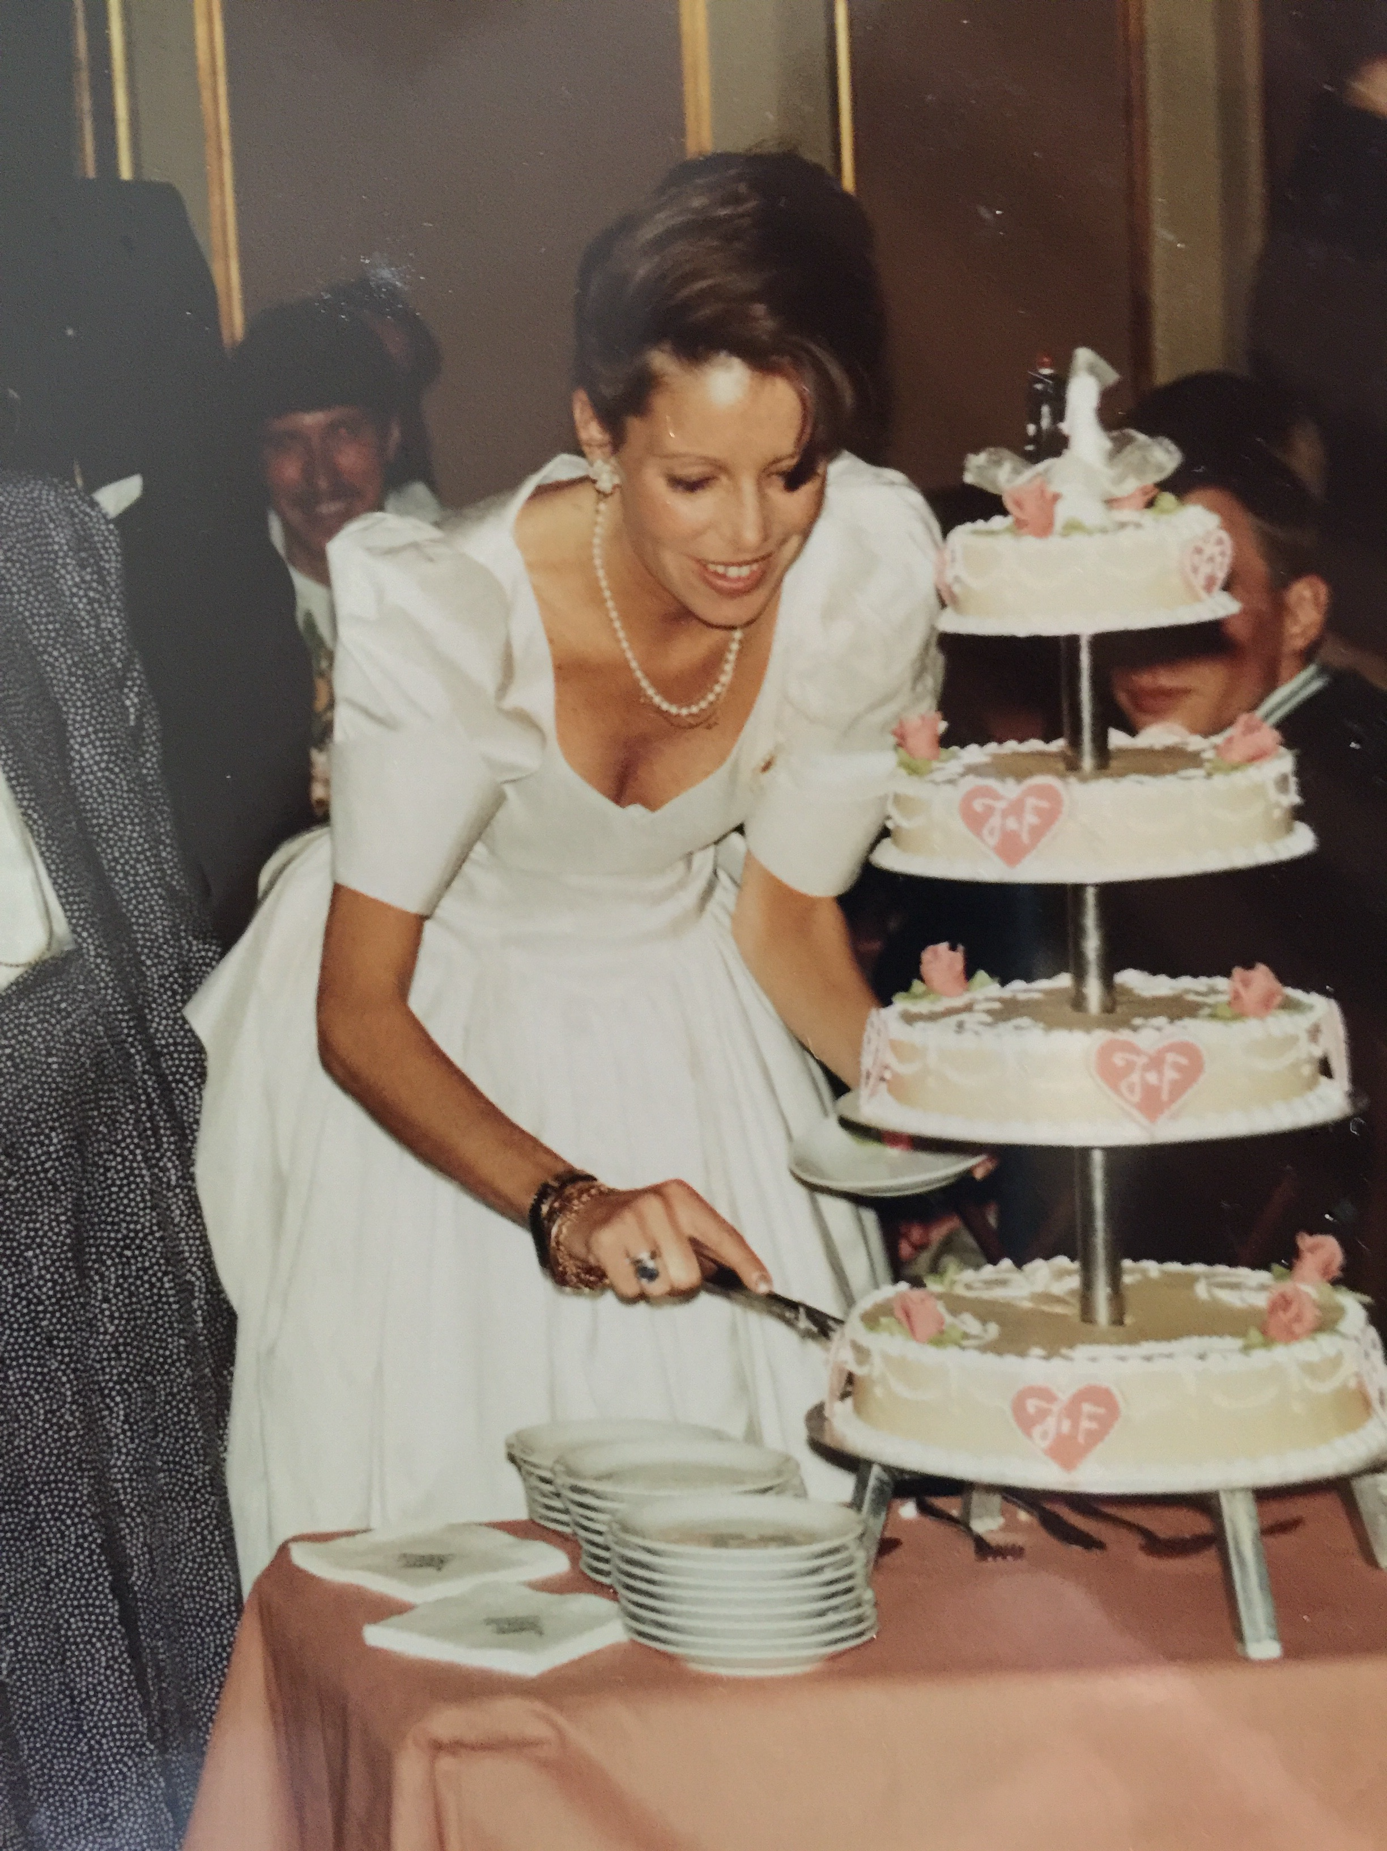
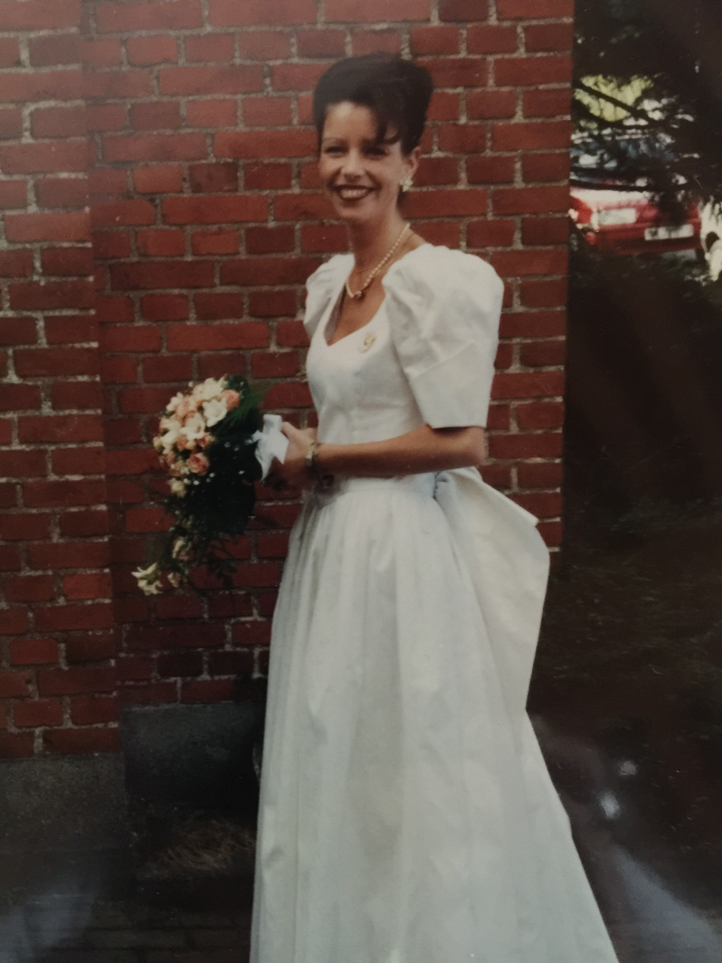
Somewhere along the ways this happened….

Slide 5
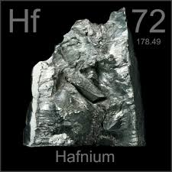
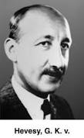
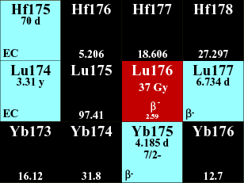
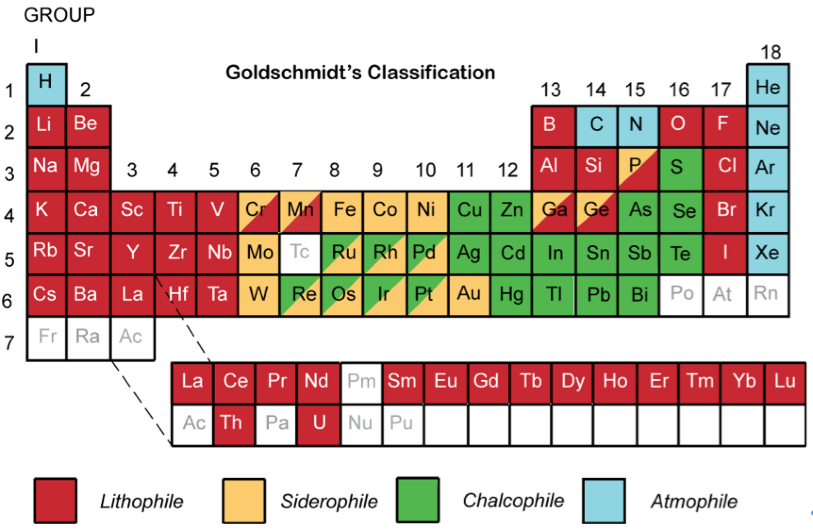
My third step (post-doc; 1994-1996)!
Hf isotopes, meteorites, MC-ICP-MS, Lyon….
The ¹⁷⁶Lu-¹⁷⁶Hf chronometer
β⁻ decay
Z
N

Slide 6
…as is often the case in science there was some initial scepticism …
Selected (in)famous verbatims by famous isotope geochemists on MC-ICP-MS and hf isotopes….

Slide 7
“come on! Surely Francis is not going to buy a machine just
to do hf isotopes?!”
®C.J. Allègre, 1994, on francis’ mc-icp-ms proposal

Slide 8
“this is a pointless machine!”
®p.j. patchett, aka mr hafnium, 1994, on mc-icp-ms

Slide 9
“this project can’t be done!”
®R.K. O’nions, 1994, on my marie-curie post-doc proposal to measure hf isotopes in chondrites
“but let her try anyway!”

Slide 10
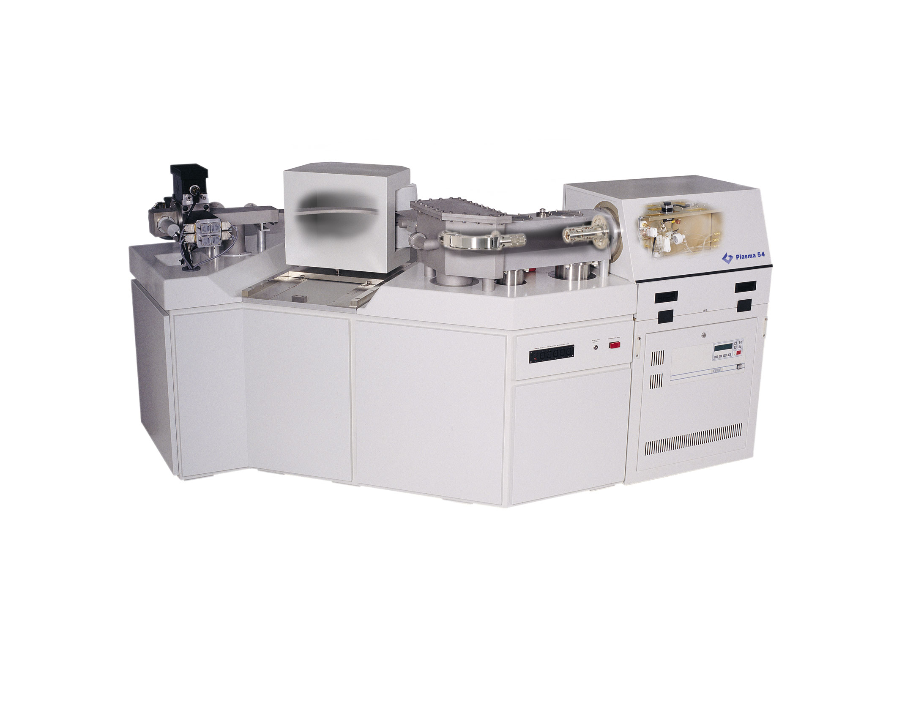
Christmas 1994: The VG “Plasma 54”
The World’s first commercial MC-ICP-MS
Game changer

Slide 11
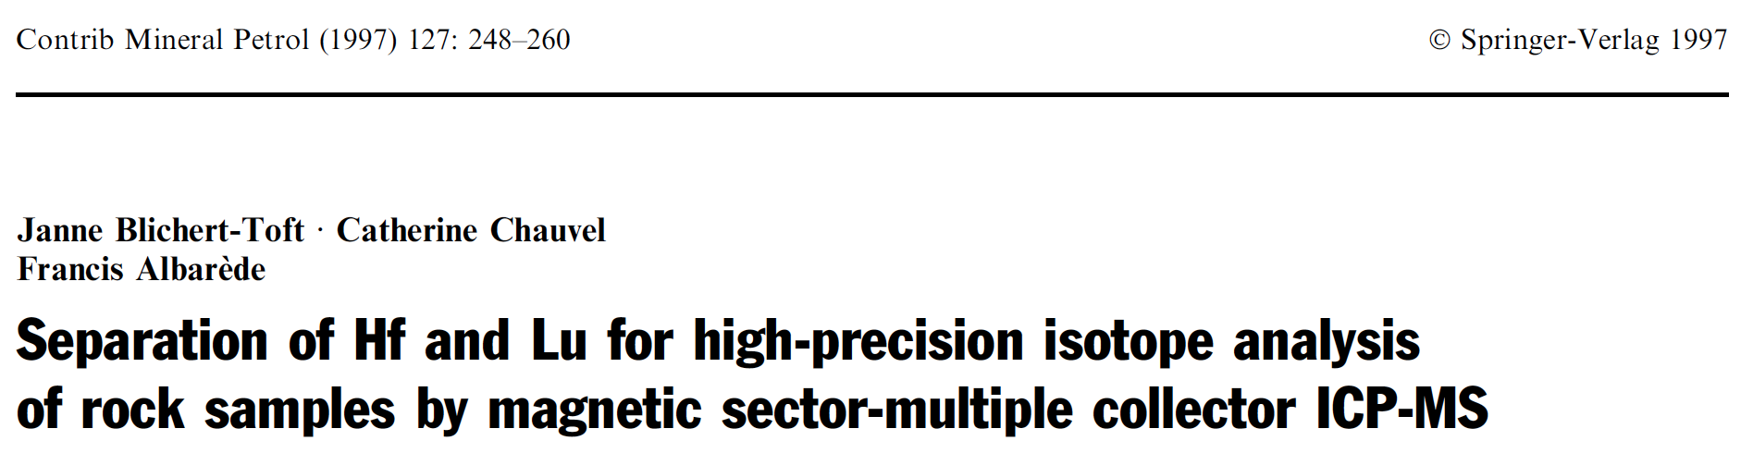
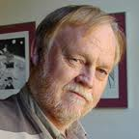
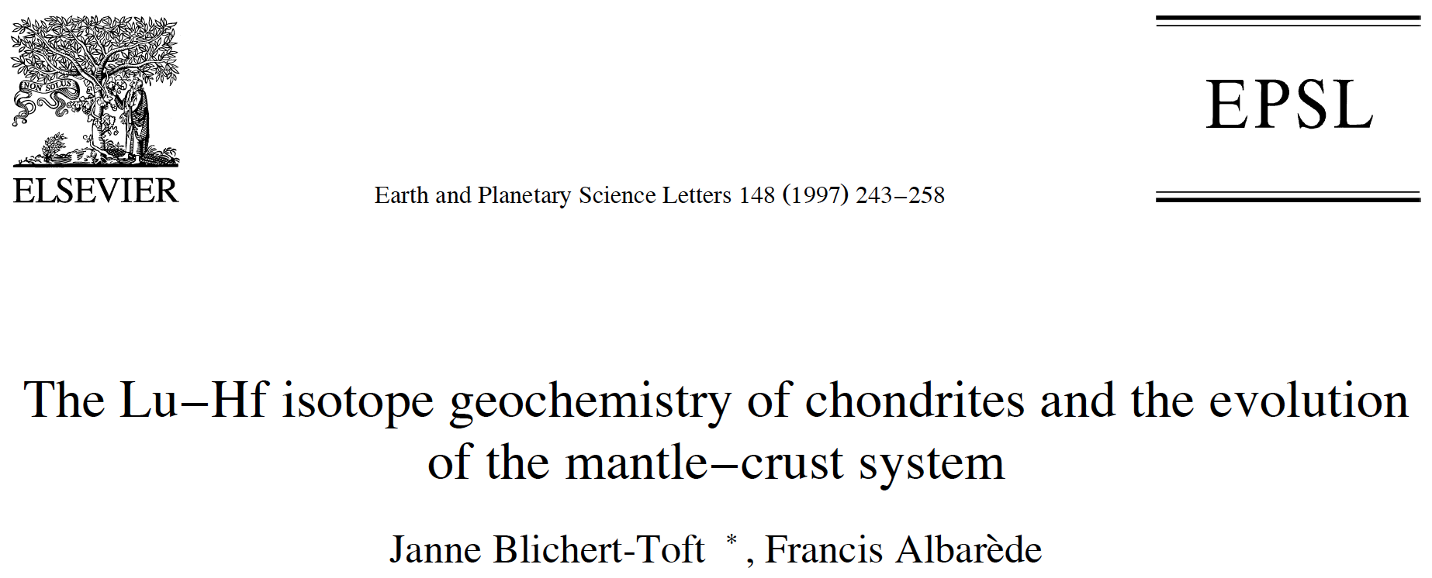

¹⁷⁶Hf/¹⁷⁷Hf_{CHUR} = 0.282772 ± 0.000029
¹⁷⁶Hf/¹⁷⁷Hf_{i} = 0.279718 ± 0.000029
¹⁷⁶Lu/¹⁷⁷Hf = 0.0332 ± 0.0002
Cited >2000 times

Slide 12
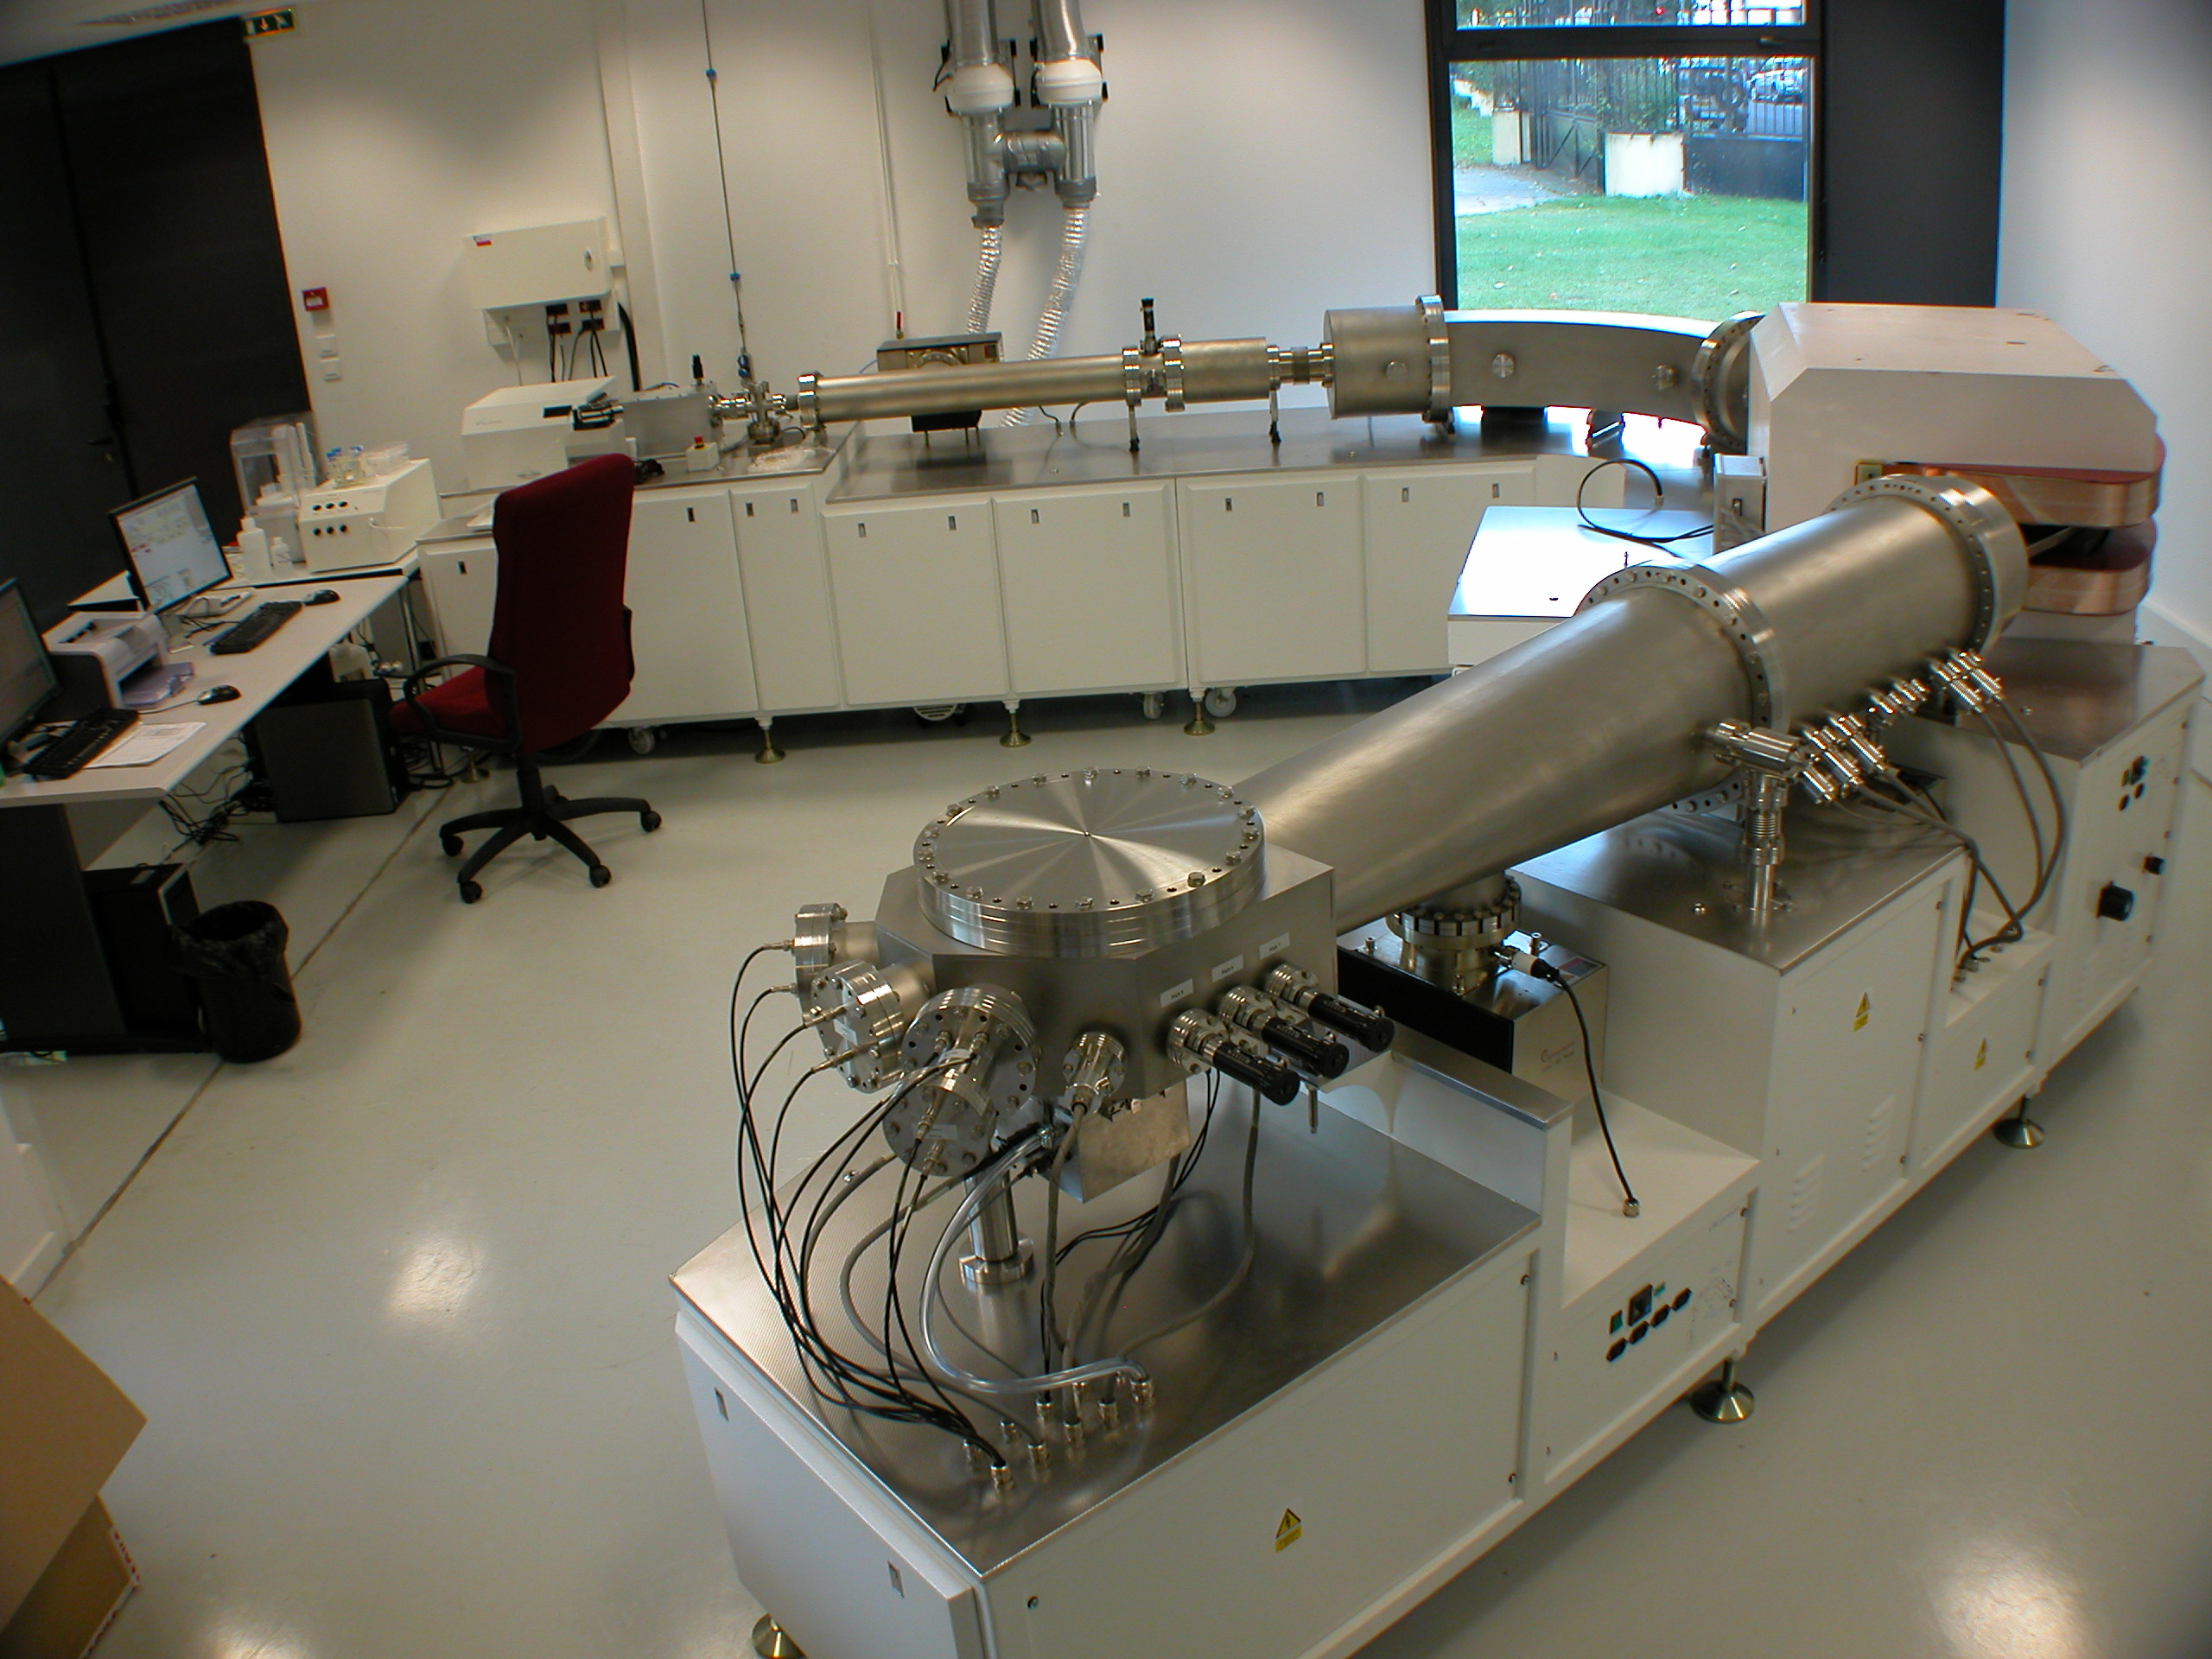
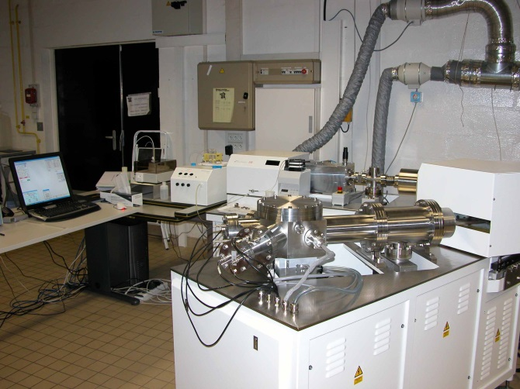
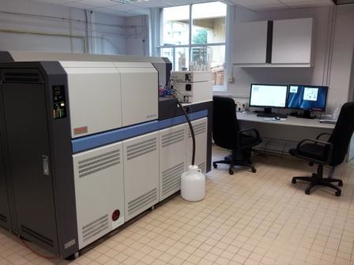
My fourth step (and first job as an isotope geochemist)!
CNRS and the next 21 years (1997-2018)…
Nu 1700 HR
…with MC-ICP-MS….
Nu Plasma 500 HR
…and Francis, Philippe,
and our students….
Thermo Neptune Plus

Slide 13
The isotope geochemist…
…commands time Owing to the absolute constancy of radioactive decay and radiogenic ingrowth, and, by mastering the arts of chemistry and mass spectrometry, can tell when events happened (dating) and what were their nature and origins (tracing). the element of time is the one thing allowing the geochemist to understand how
things have evolved.

Slide 14
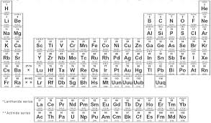
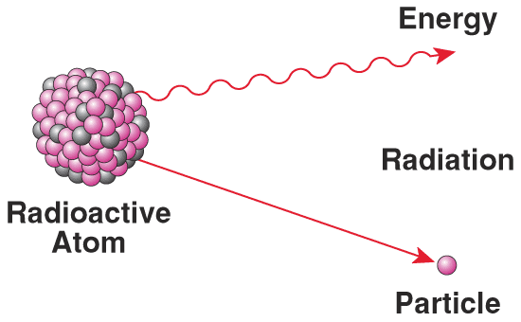
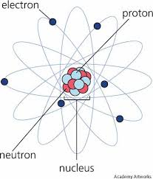
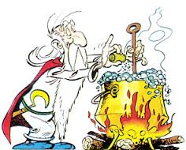
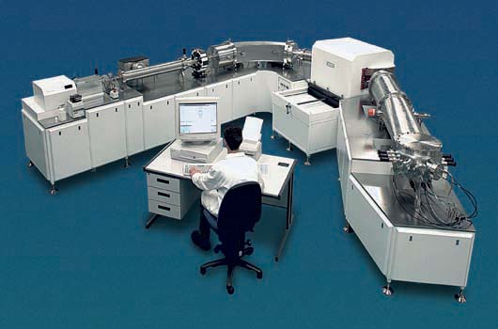
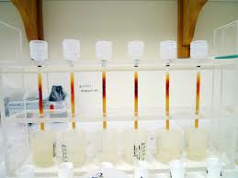
My tools!

Slide 15
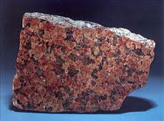
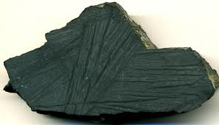
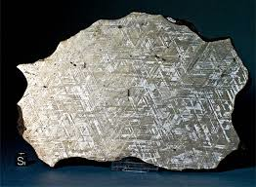
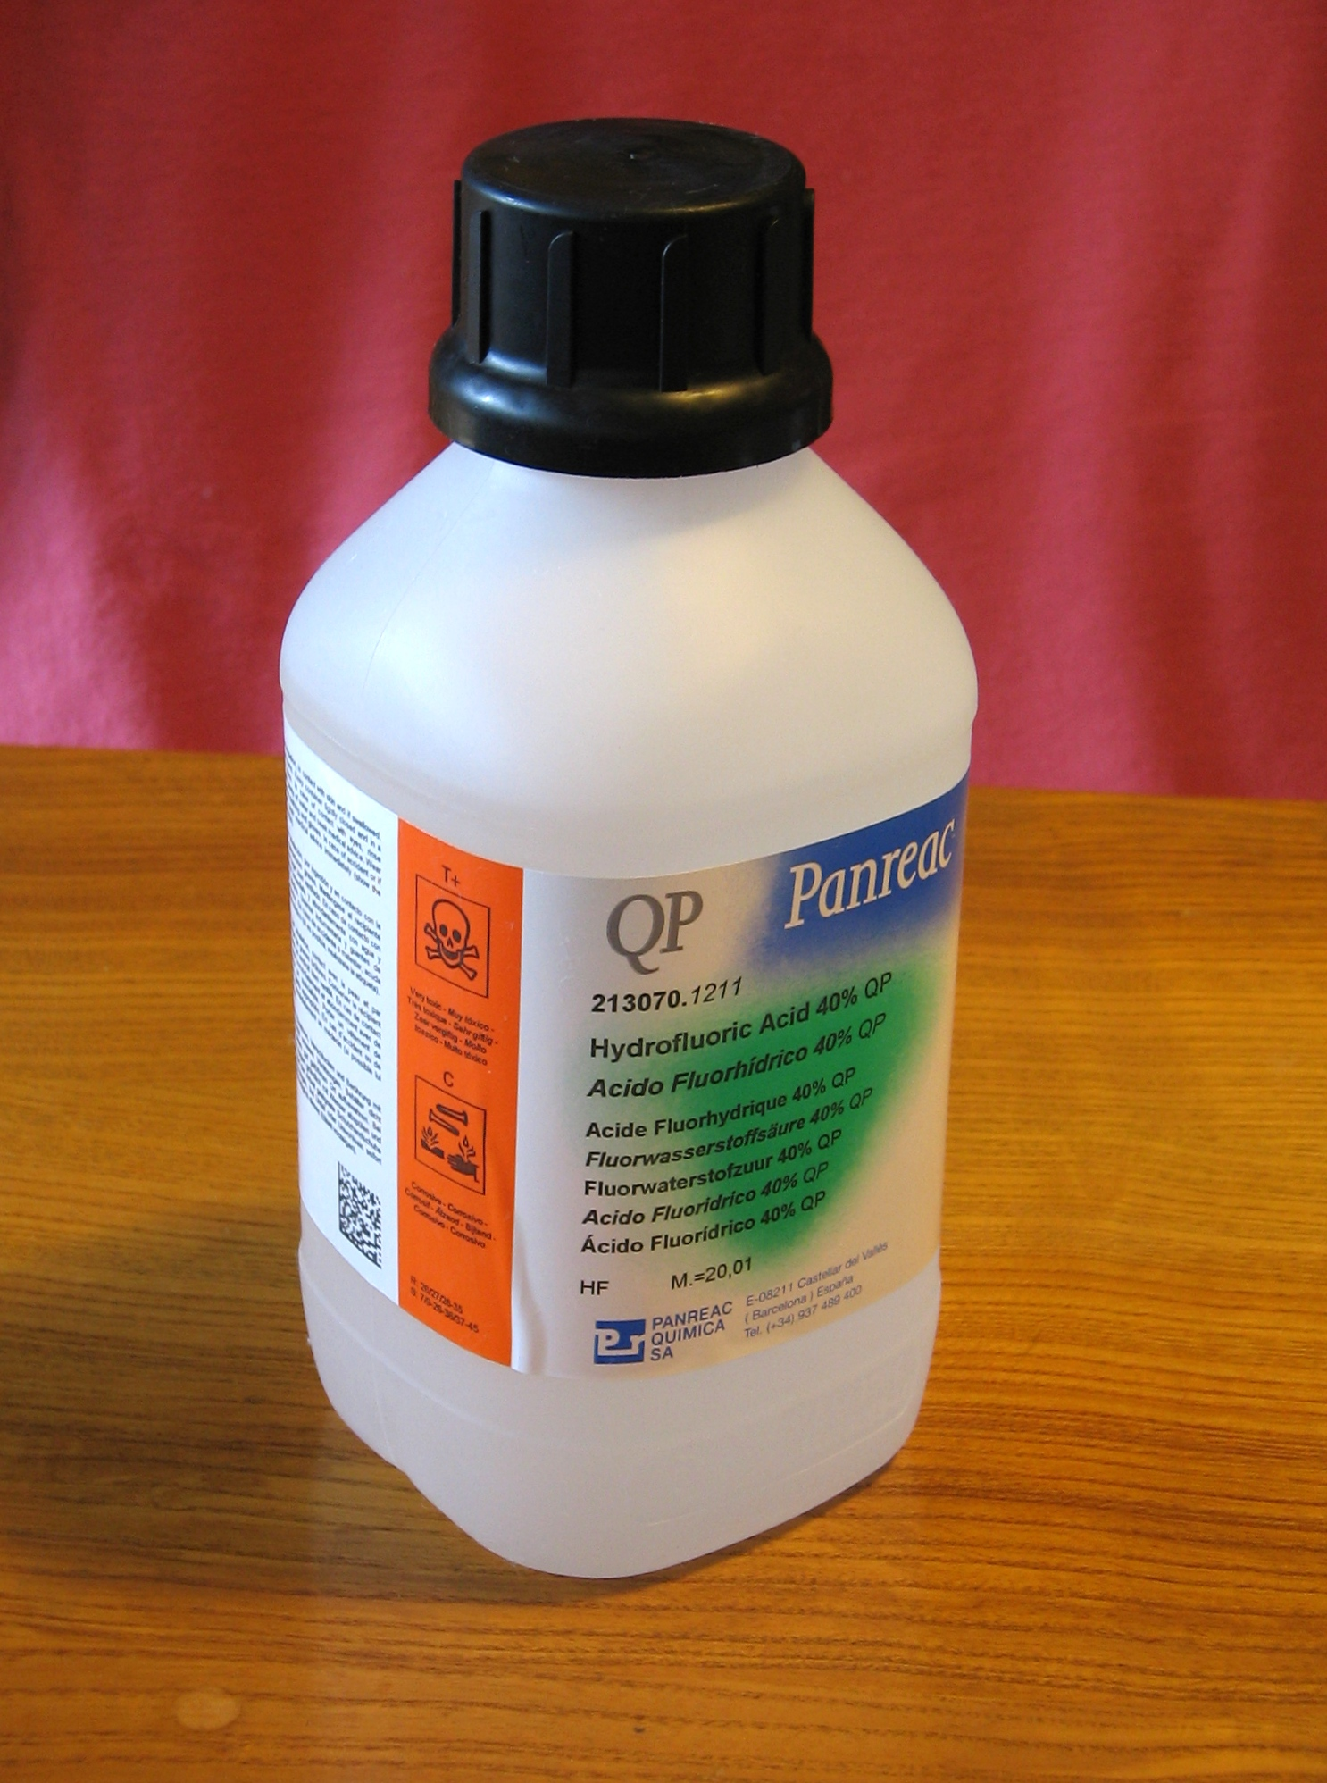
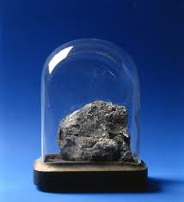
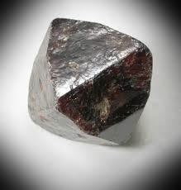

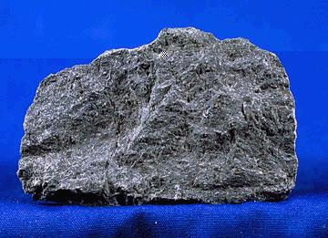
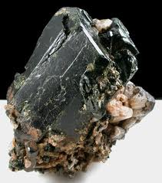
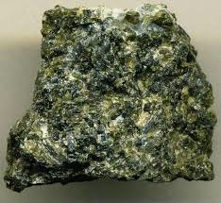
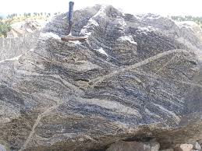
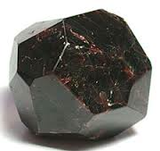

My materials (so far)!
MC-
ICP-MS

Slide 16




To what end?
Dating and tracing the dynamics and evolution of Earth and our Solar System…
Why?
“Fair is what we see…
Fairer what we have perceived…
Fairest what is still in veil…”
Steno 1673

Slide 17


My fifth step: SILVER!
At the crossroads of archeology, geochemistry…
…economics….
…and (Roman) history….

Slide 18

What I know about the Antiquity and Roman history!
Asterix. Volumes 1-30.

Slide 19







Our SILVER materials!

Slide 20
To what end? How?
To understand early monetized economies and the rise of money in the Antiquity
Using Ag and Pb isotopes in silver coins, artifacts, and ores to elucidate fundamental mechanisms of economic development in the antique Mediterranean world by identifying silver mineral sources and monetary sinks and delineating their major transfer routes
The overarching key question posed by SILVER is whether metal availability drove economic development or mining developed in response to rising economies

Slide 21

Deliverables!
Post-SILVER?

