Slide 1
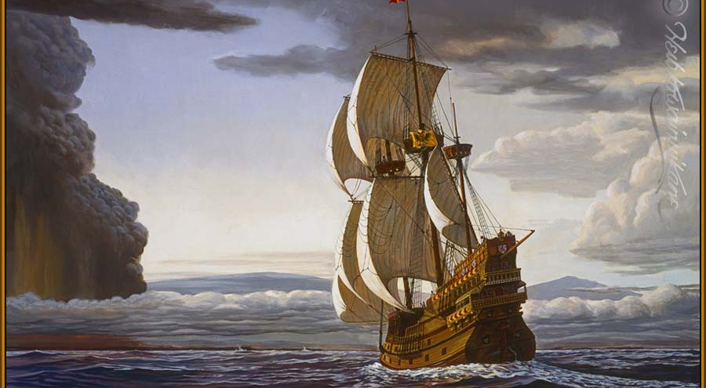
A Distant Whisper …
How Geochemical Tracers
Speak of Ancient Economies
& Past Environments
Francis Albarède
Francis Albarède

Slide 2
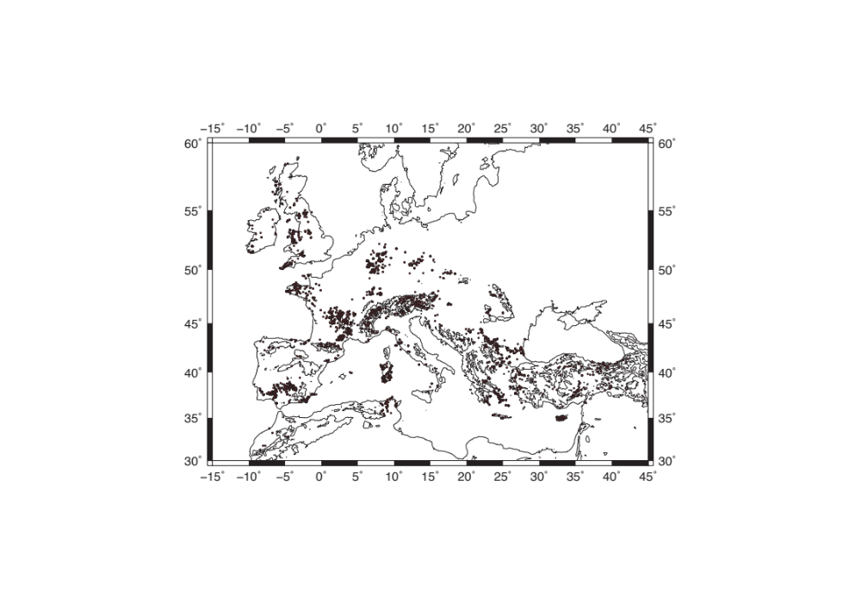
PbS mining in
Europe and Asia Minor

Slide 3
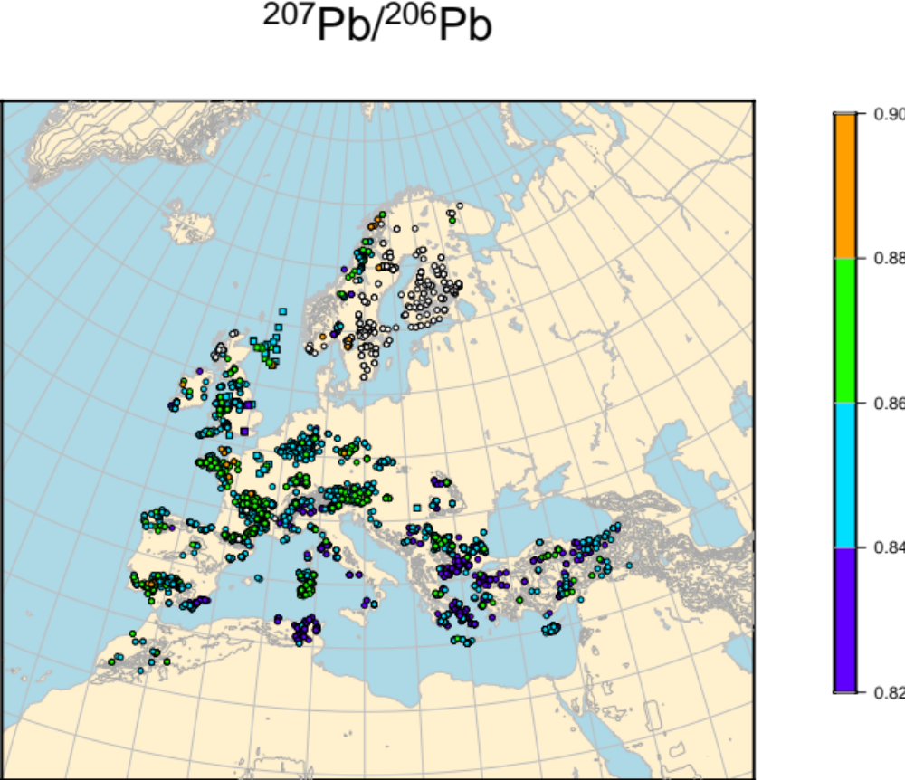
Lead isotopes have been used to establish artifact provenance, but they are not very discriminant

Slide 4
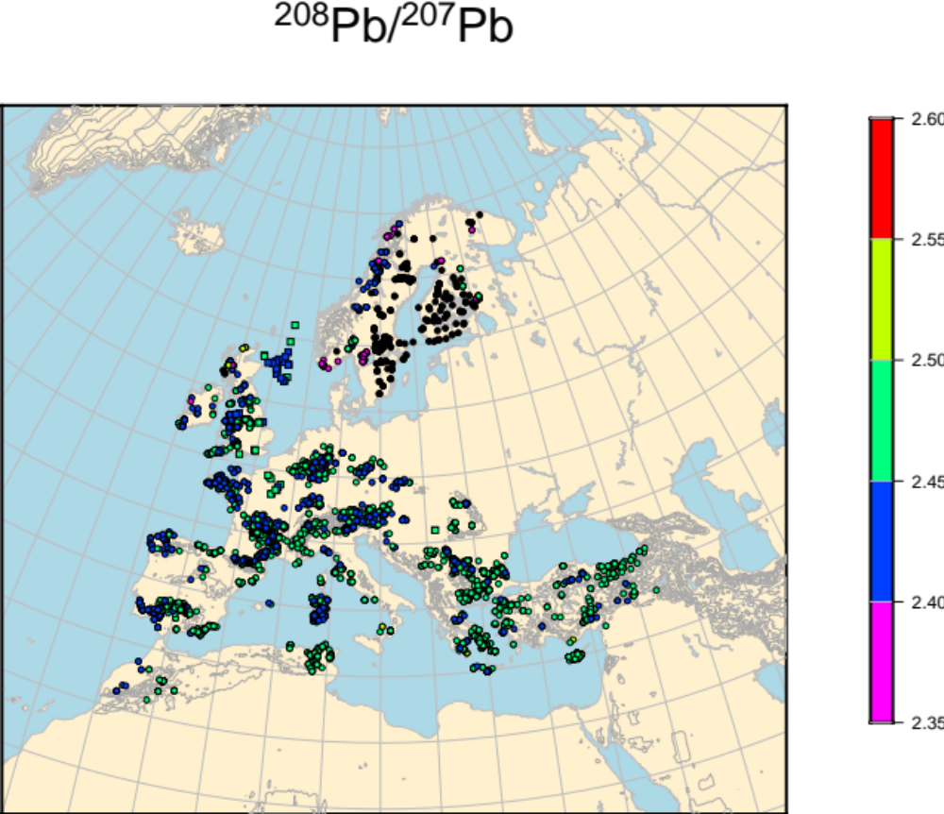

Slide 5
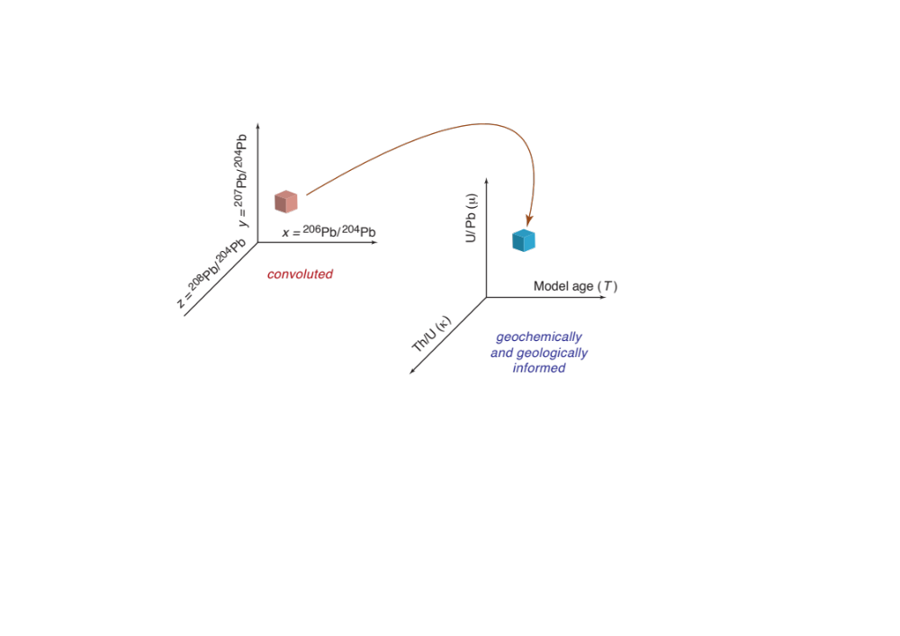
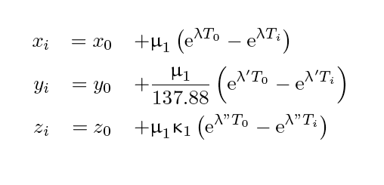
Radiogenic lead Isotopes:
Make them ‘speak’ through a 2-stage model
System of 3 equations in 3 unknowns
T_{i}, μ₁, and κ₁ are independent, x_{i}, y_{i}, z_{i} are not

Slide 6
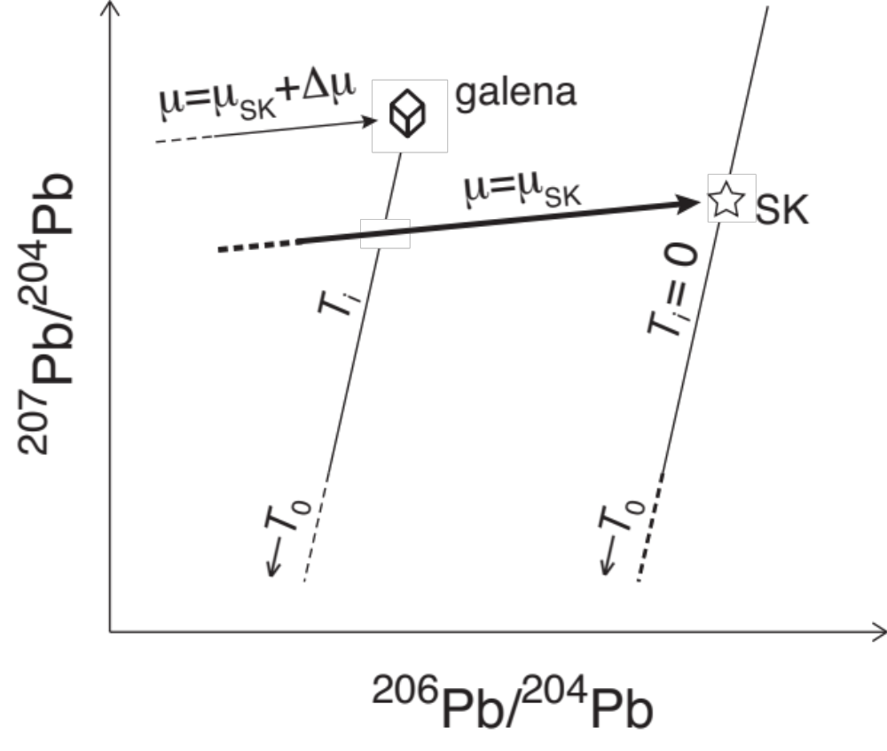
Model ages and μ values

Slide 7
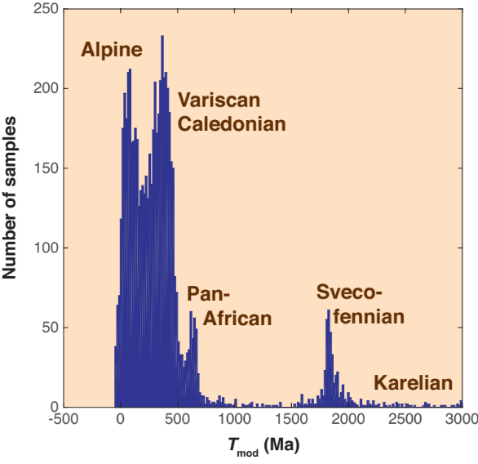
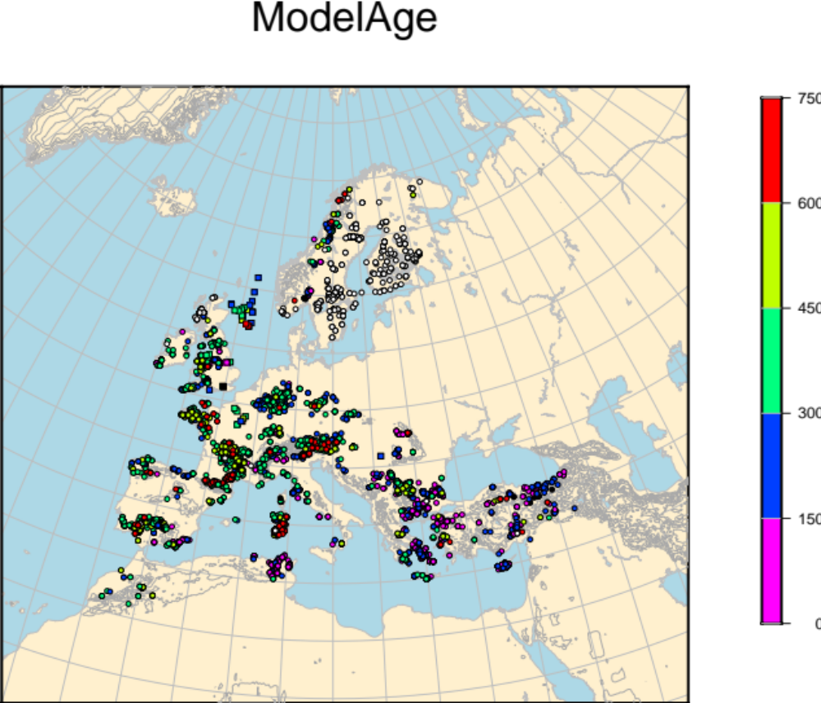
Model ages are consistent with tectonic ages

Slide 8
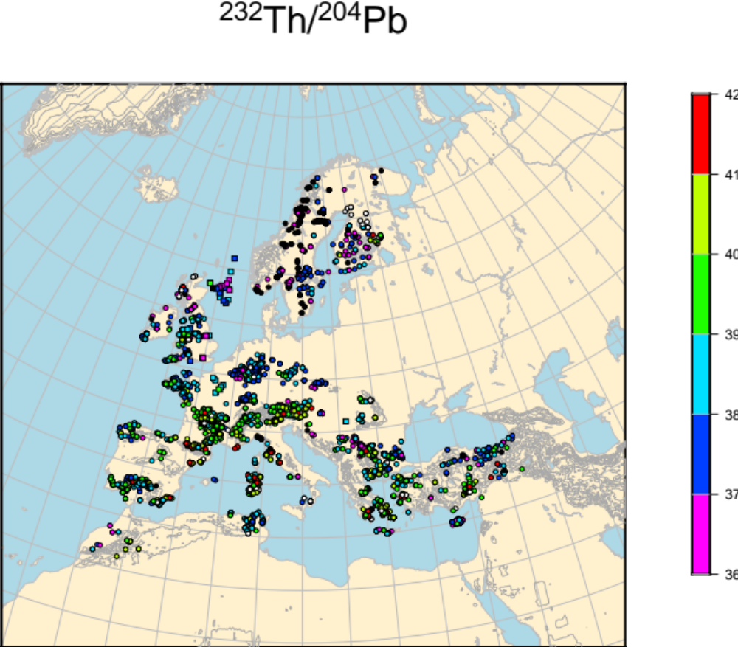
Model U/Pb and Th/Pb inferred from Pb isotopes are other powerful provenance variables

Slide 9
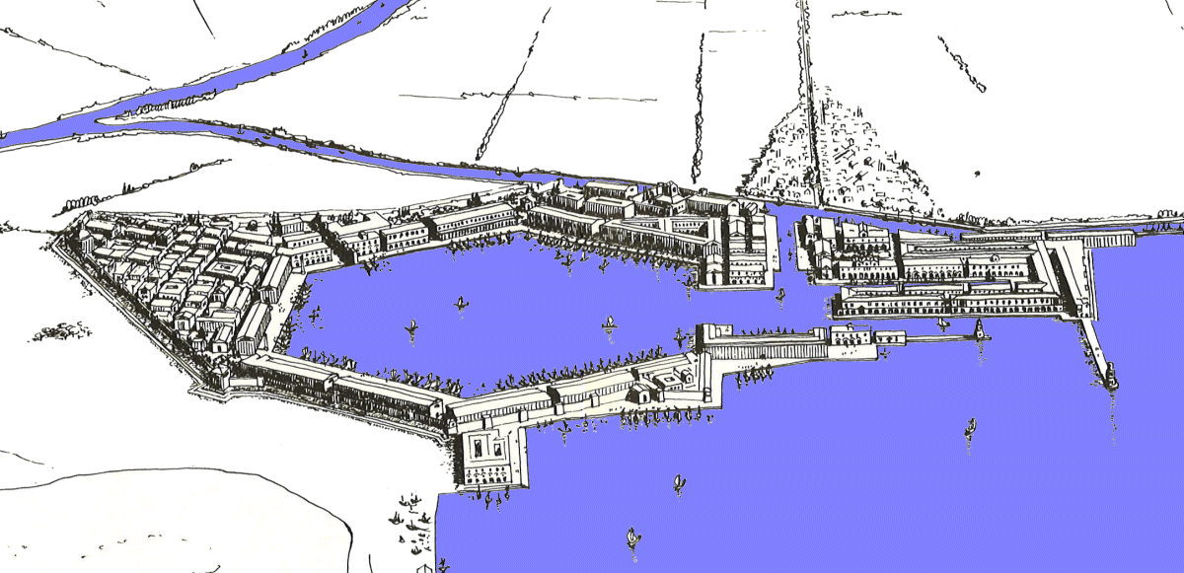
Portus (end of 1st century AD)
Tiber
Rome

Slide 10
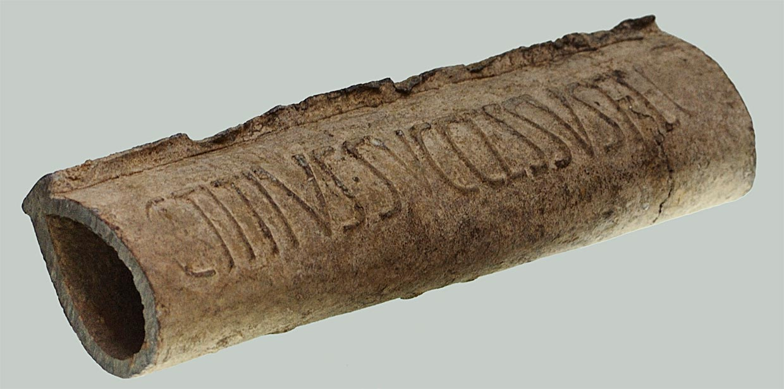
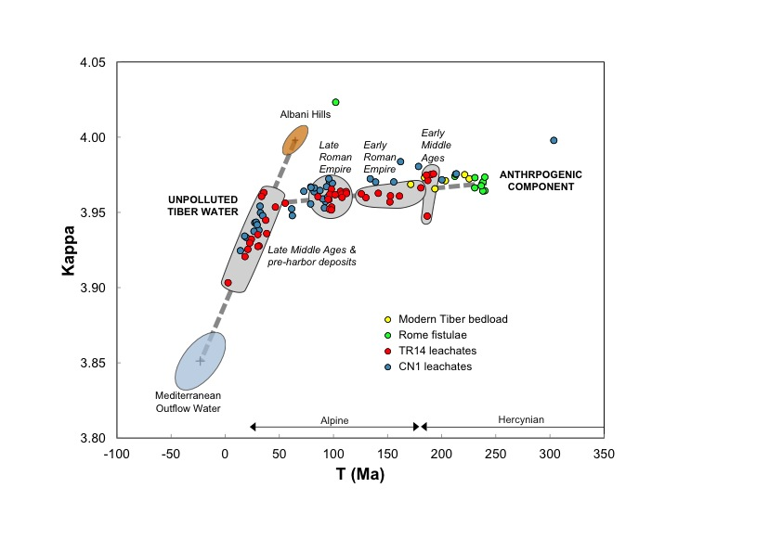
Water from the Tiber and at Portus carry Hercynian Pb (~250 Ma old) unknown in central Italy. Such an ‘old’ Pb signals the lead pipes used for water distribution in Rome (fistulae) from the 1st century BC.

Slide 11
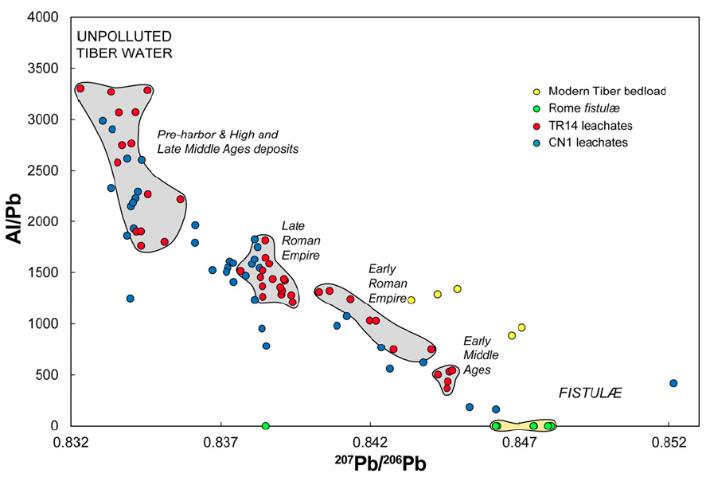
Pb isotopes in Tiber sediments show that the river downstream of Rome contained 100 times more Pb than the original springwater.
Notes:
Graphique opposant le rapport isotopique ²⁰⁷Pb/²⁰⁶Pb et le rapport Al/Pb des échantillons du Tibre actuel, des fistules de Rome et des carottes sédimentaires. Le champ beige correspond à la composante anthropogénique symbolisée par les échantillons des tuyaux de plomb. Ce graphique montre que les échantillons des carottes sédimentaires sont issus d’un mélange plus ou moins important entre les composantes anthropogénique et naturelle selon les périodes historiques considérées.
Al/Pb vs. 207Pb/206Pb showing the TR14 (red) and CN1 (blue) core leachates, the modern Tiber bedload (yellow), and the Rome fistulæ (green). The beige field corresponds to the anthropogenic component characterized by the fistulæ. Symbols and parameters are as in Fig. 2. This plot shows that the Al-free, and therefore suspension-free, water component has the same Pb isotope composition as the fistulæ and therefore corresponds to clear water from the city water distribution system.
Fistulæ increased Pb in the water distributed in ancient Rome over the natural level by a factor of ∼100.
Although this attest to general Pb pollution of Roman drinking water, the concentrations at issue are unlikely to have represented a major health risk

Slide 12
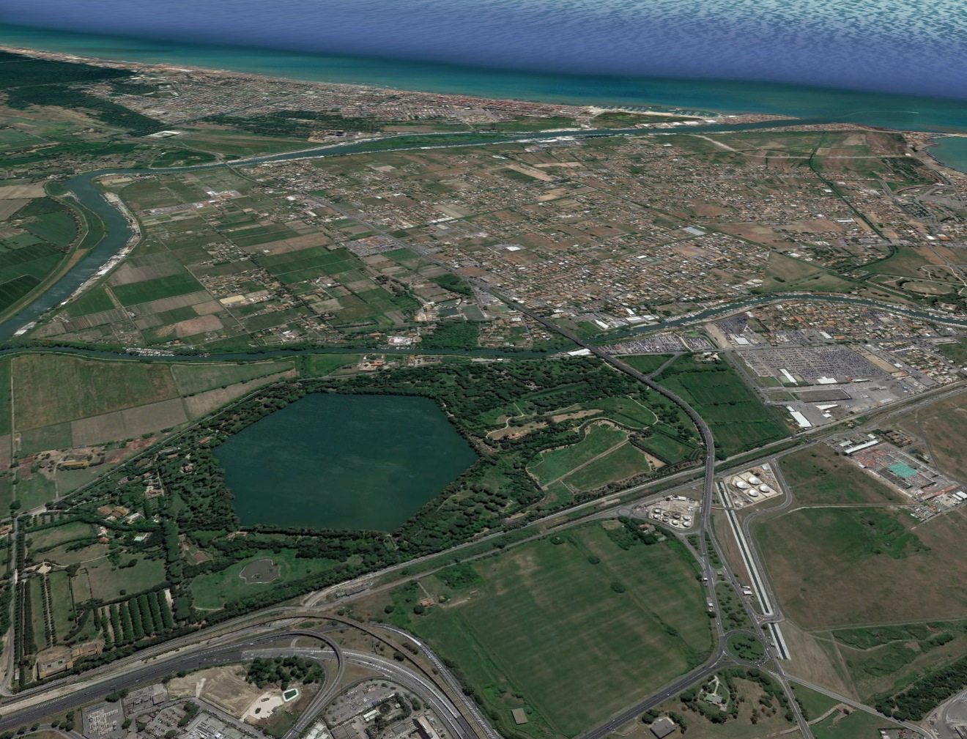
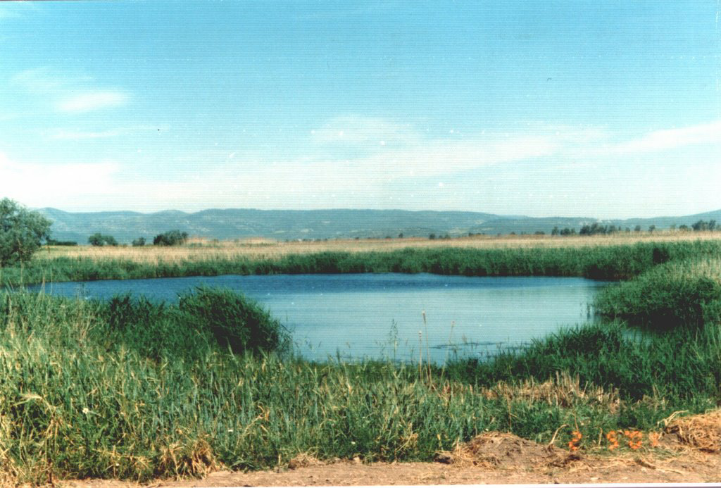
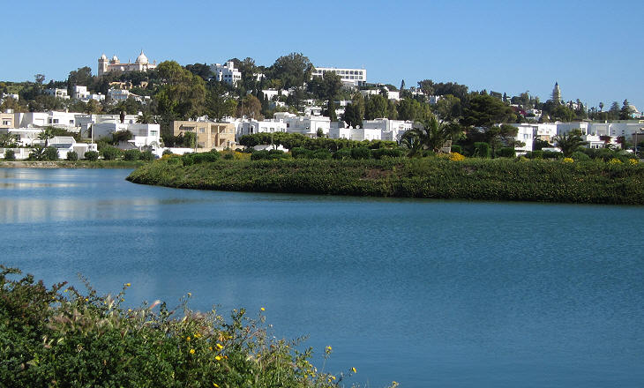
Environment, harbors, wars and trade
Carthage (Tunis)
Portus (Rome)
Ephesus (Asia Minor)

Slide 13
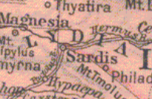
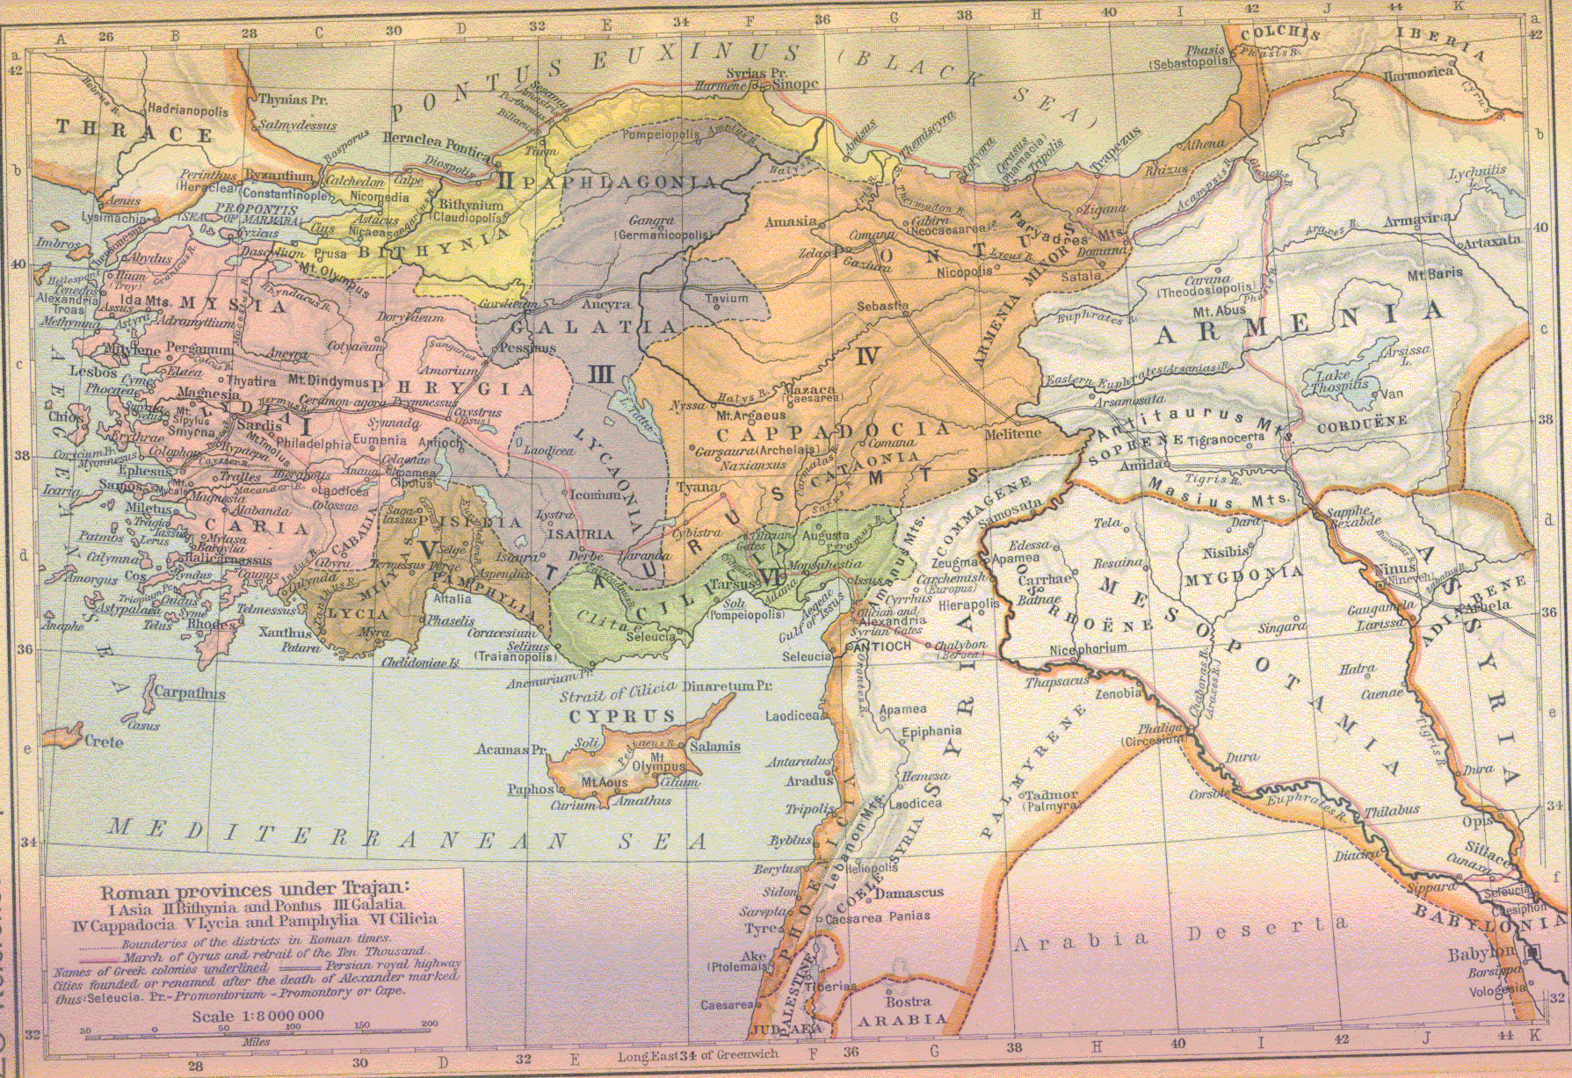
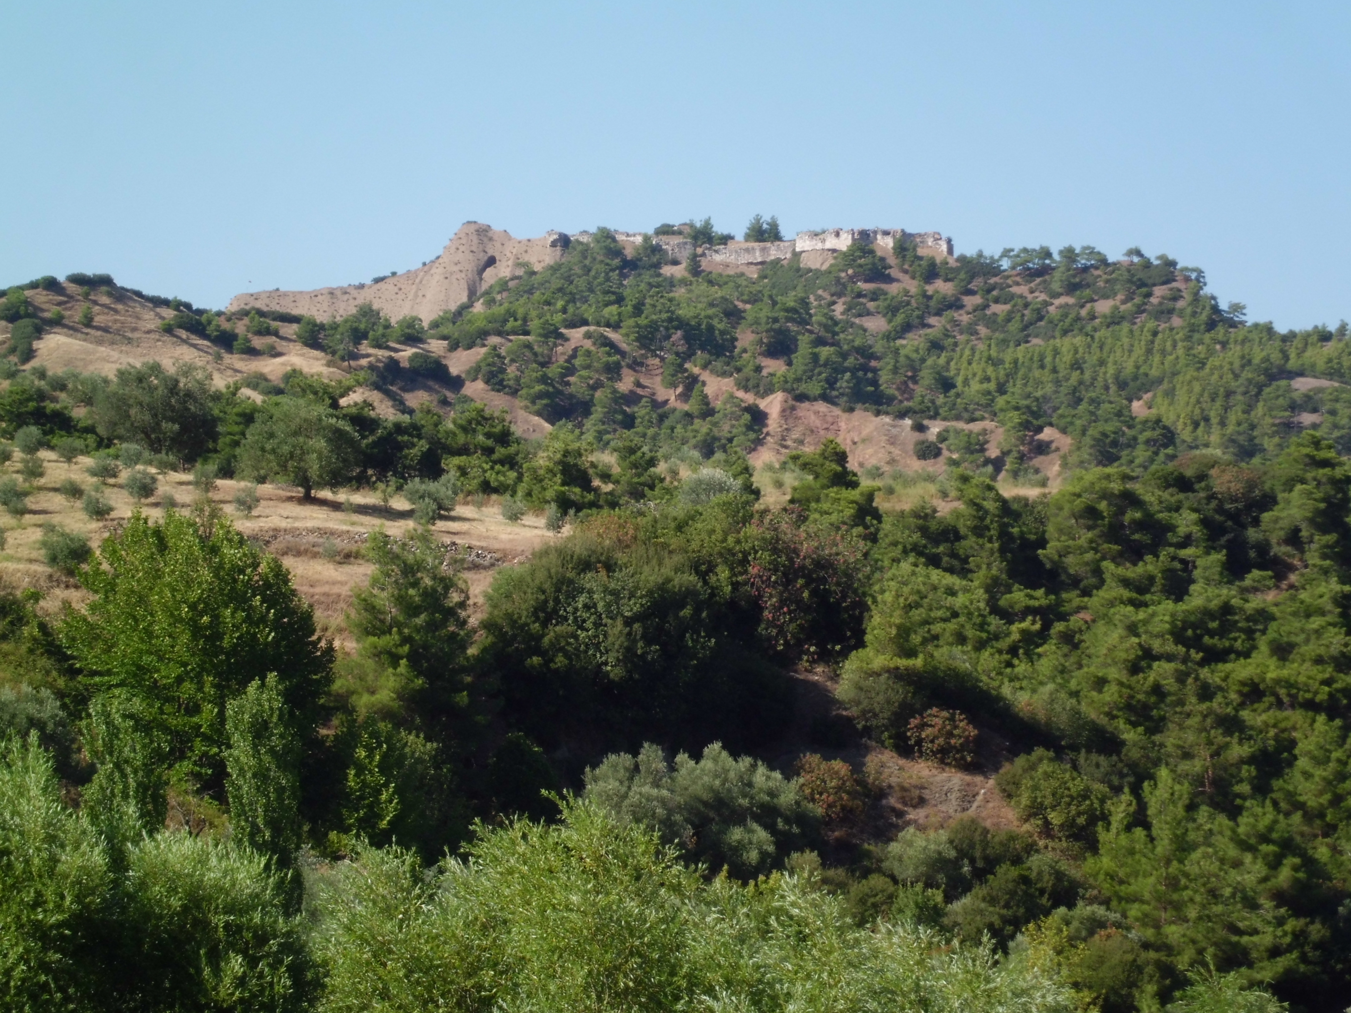
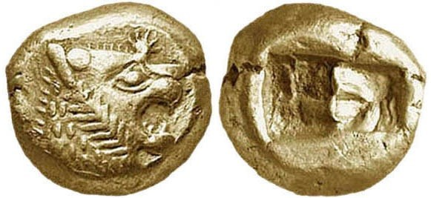
Money, money:
Where it all began …
King Croesus Acropolis in Sardis
610 BC

Slide 14
New stable isotopic tracers (Cu and Ag) are particularly useful for reducing possible provenance guesses of precious metal
Silver is a trace component of galena (PbS) (up to 2 percent)
Sulfosalts (As, Sb) are also mined for Ag
Silver was extracted through time from well-defined provinces:
Zagros, Aegean, Betic
Bohemia
Peru, Mexico

Slide 15
Prevalence of ancient silver mines in the Mediterranean world
Domergue (2008)

Slide 16
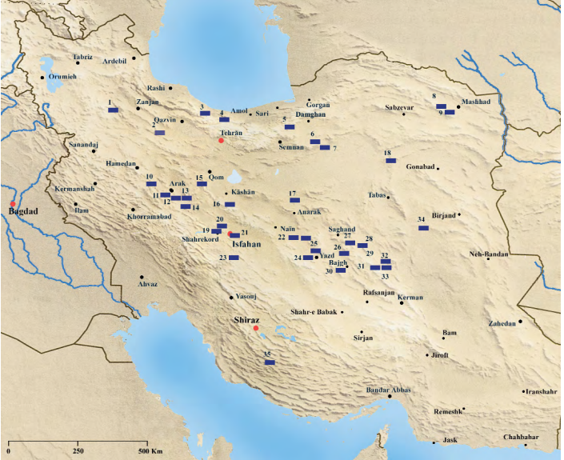
Silver mines from the central Persian plateau
Momenzadeh M. (2004)
Persepolis capture in 330 gave Alexander the Great control over 2500 tons of silver and gold. It took 3000 camels to carry the booty to Greece.

Slide 17
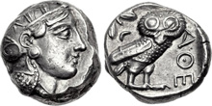
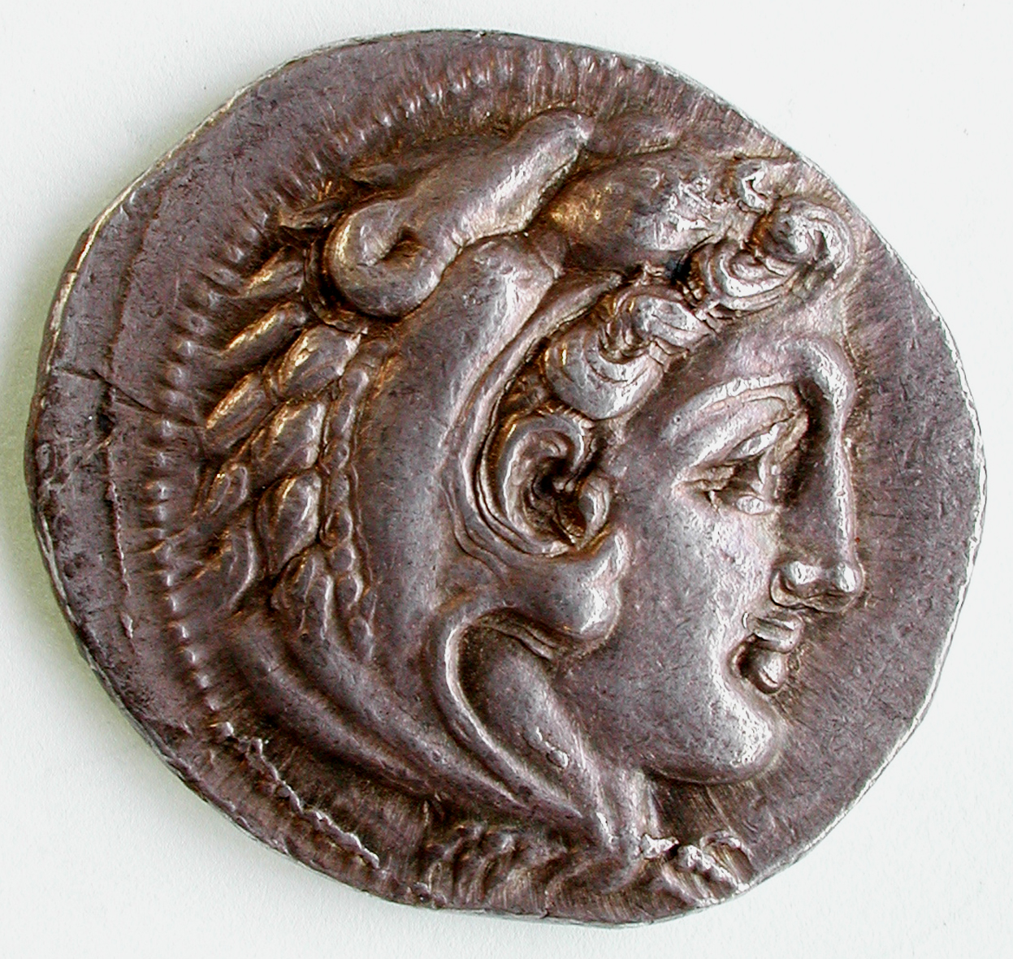
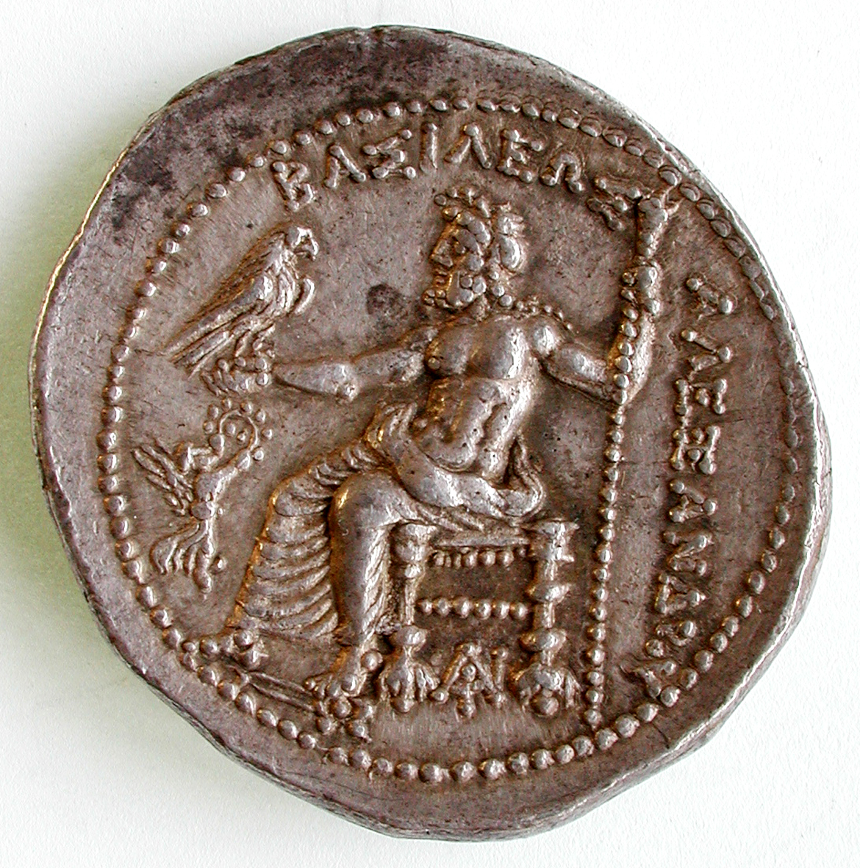
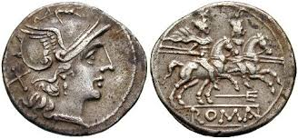
Alexander the Great tetradrachm (booty of Persian treasures)
$$ of the past
Athenian owl
Roman Republic denarius

Slide 18
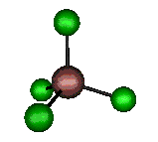
The nature of stable isotope fractionation (e.g., ⁶⁵Cu/⁶³Cu, ¹⁰⁹Ag/¹⁰⁷Ag)
A quantum effect rooted in the Heisenberg principle of uncertainty, which requires the lowest level of vibrational energy (called Zero Point Energy) to remain finite .
The energy of a bond increases with the frequency of vibration and therefore decreases with the atomic mass of the binding isotopes.
Preferential incorporation of heavy isotopes in the stiffest bonds minimizes the total energy of the system.
Heavy isotopes prefer sites with low coordination number and high oxidation states.
Isotope fractionation quickly decreases when temperatue increases

Slide 19
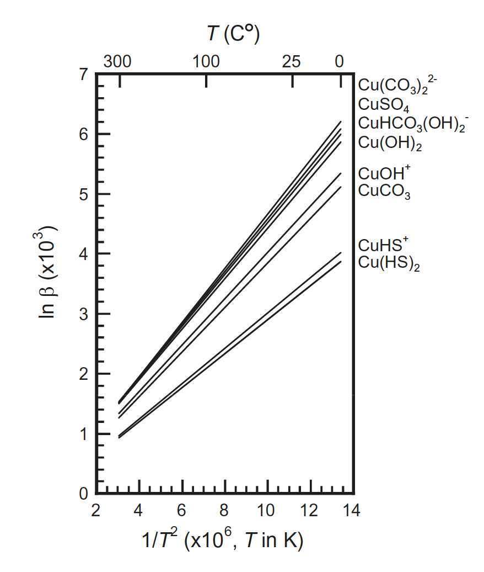
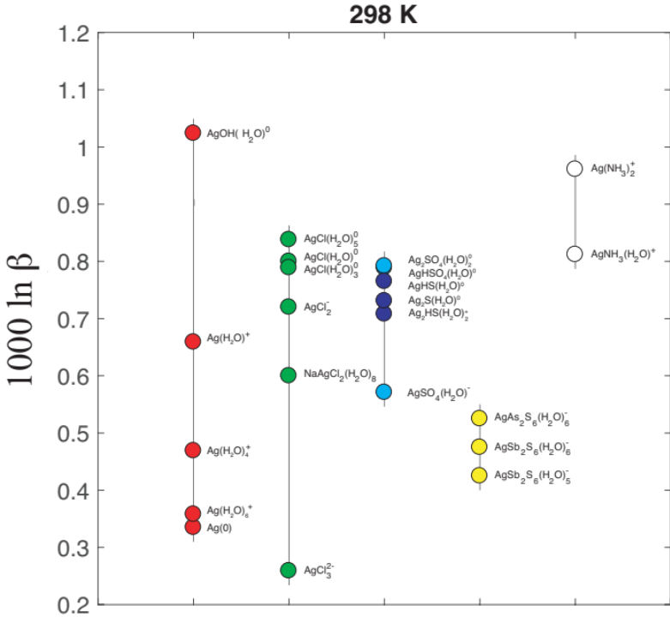
Fractionation of stable Cu and Ag isotopes can be calculated by ab initio DFT methods. It reflects the genetic contrast between the different sources. ‘Hot’ hydrothermal galena and sulfosalts vs ‘cold’ supergene deposits (native silver)
Fujii et al. (1993)
Fujii and Albarède (submitted)

Slide 20
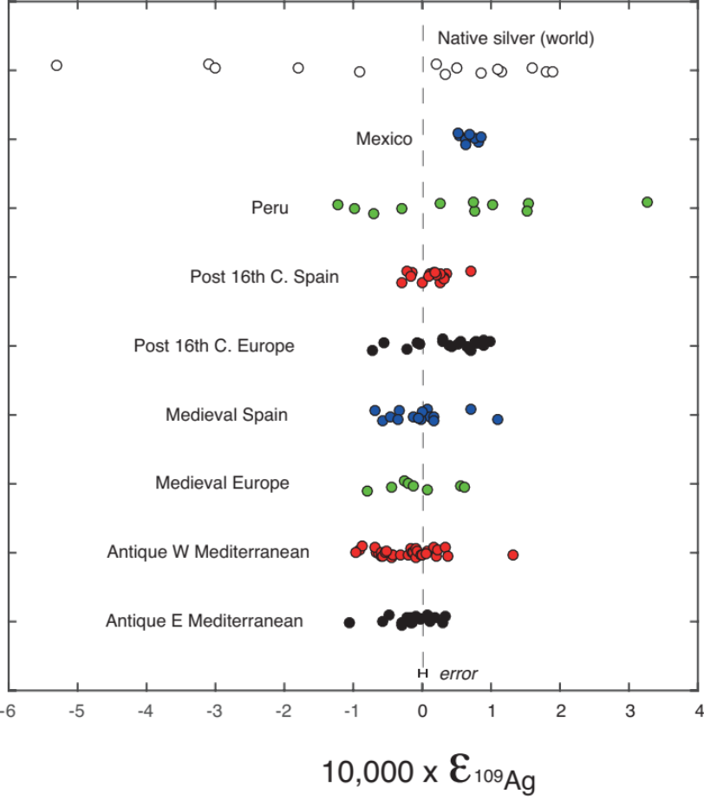
Overall ¹⁰⁹Ag/¹⁰⁷Ag isotopic variability in coinage

Slide 21
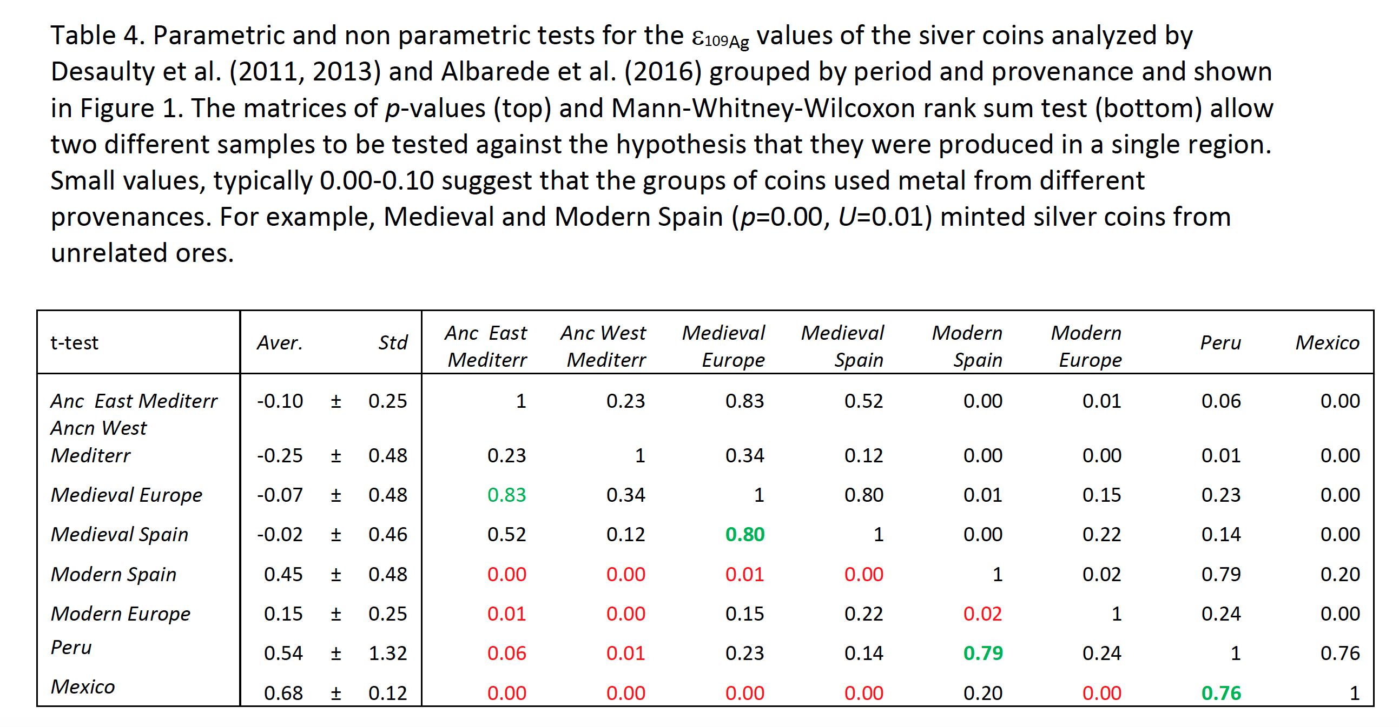
How do silver isotopes in coins relate across different empires?

Slide 22
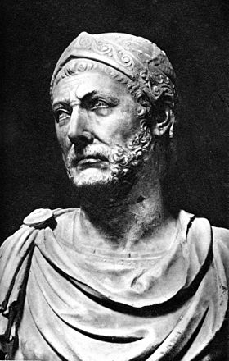
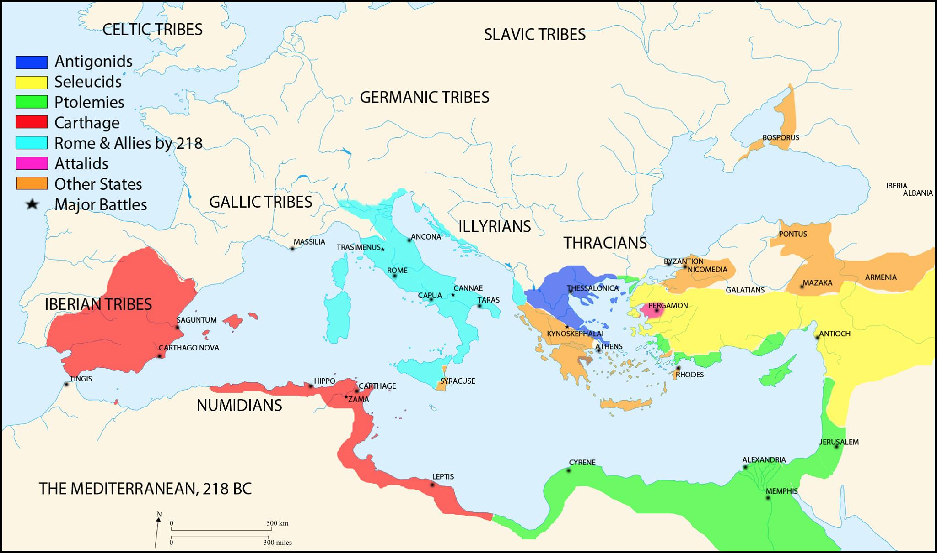
The Second Punic War
218-201 BC

Slide 23
The monetary reform of 211 BC does not correspond to silver shortage but to the input of war booty (sack of Syracuse and Capua)

Slide 24
The silver dynamic cycle

Slide 25
Silver fluxes in the first century AD
(McLaughlin, 2014)
1 talent (20 kg) = 24000 sesterces
1 million sesterces = 80 kg silver
Iberian silver production in the first century : 120 to 200 millions sesterces / year (budget 340) (10-30 tons of silver)
A soldier is paid 1 denarius (4 sesterces), or 1 drachma, a day or one aureus a month
A legion costs 11 millions sesterces a year
Only Egypt, Tunisia and Asia Minor bring more money than they spend for the defense of their borders
Silver export towards Arabia, India and China: 100 millions sesterces

Slide 26
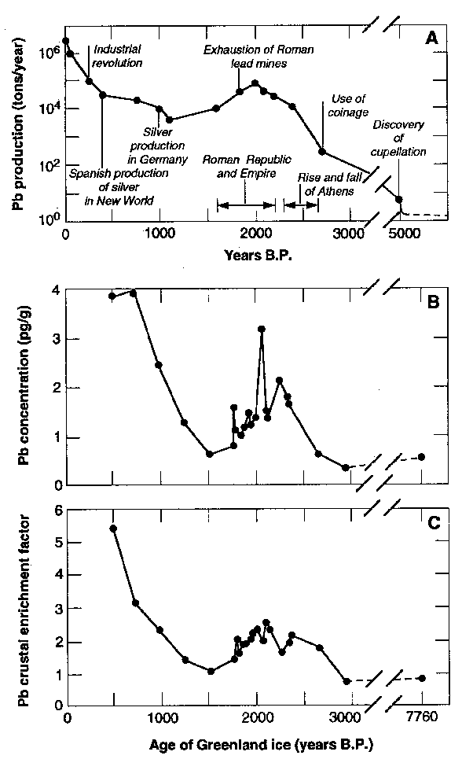
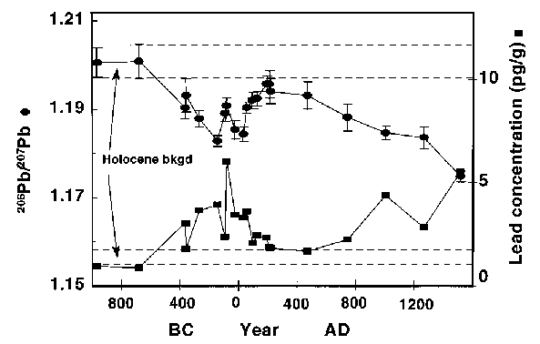
Pollution by Pb mining for silver is visible in Greenland ice
Rosman et al. (1997)
Hong et al. (1994)

Slide 27
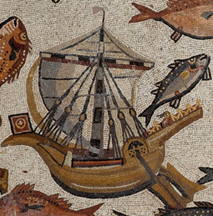
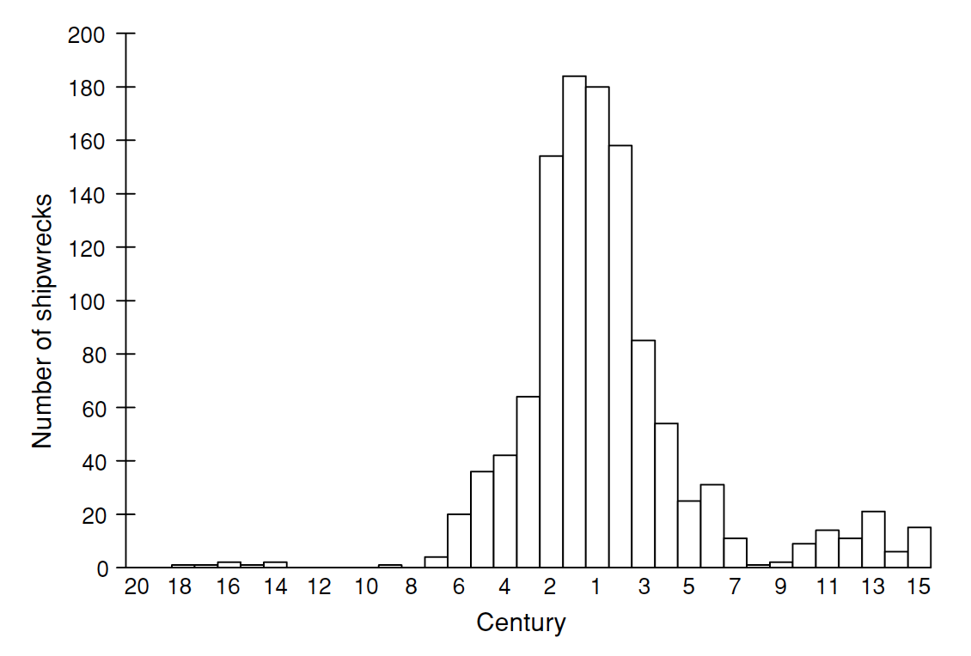
Mediterrannean shipwrecks
Parker (1992)

Slide 28
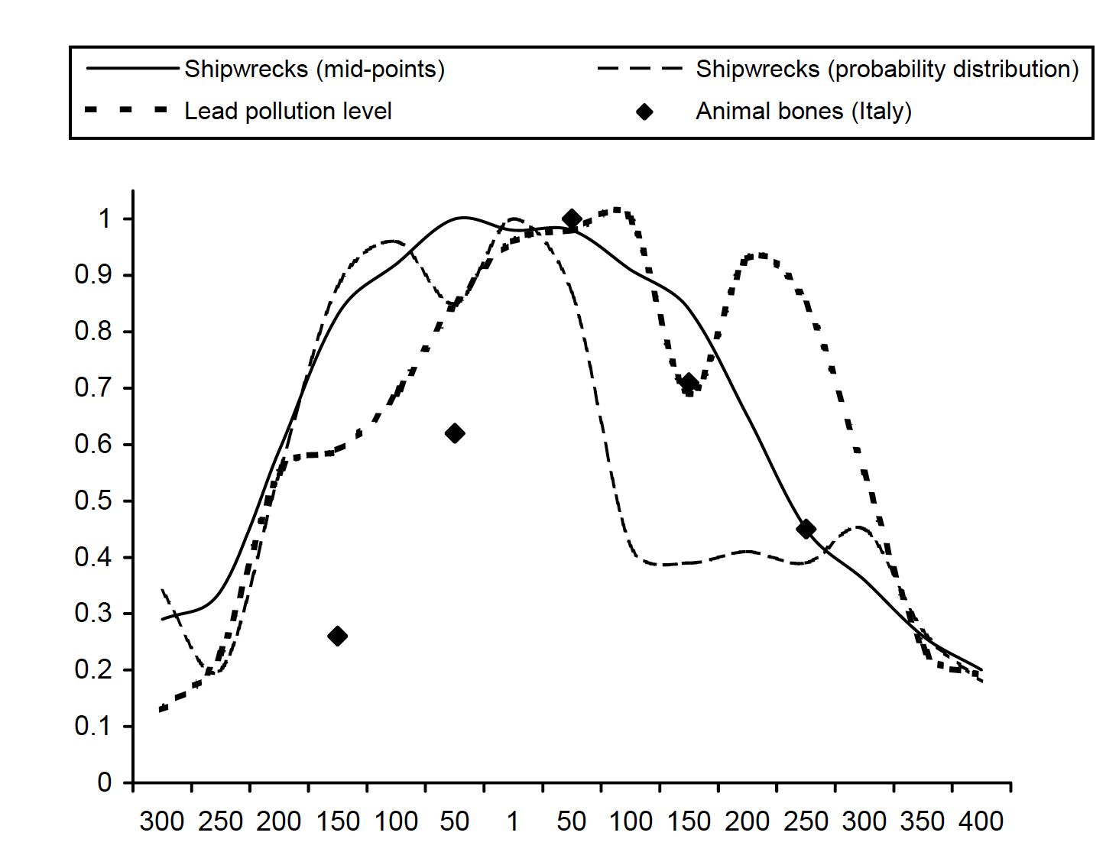
Silver and economic activity: shipwrecks, pollution, and meat consumption
Scheidel (2008)

Slide 29
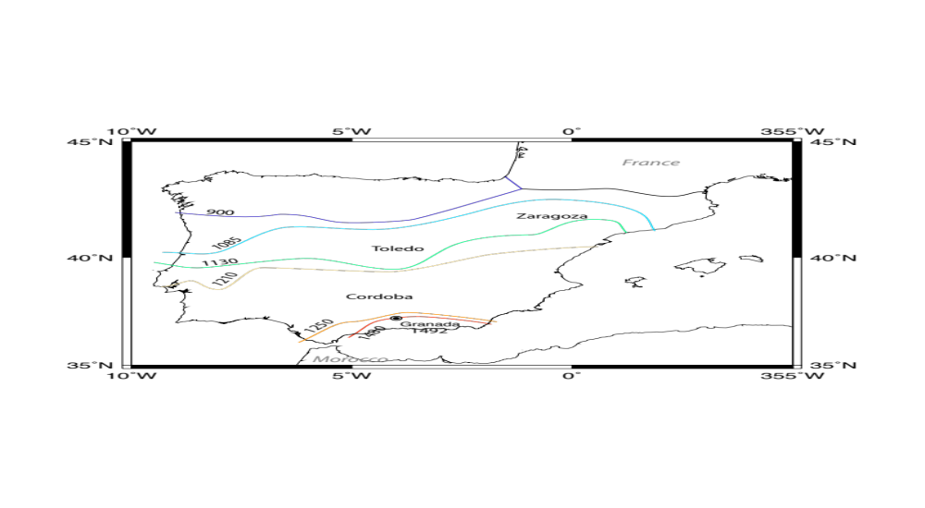
The Reconquista: the long agony of Al Andalus

Slide 30
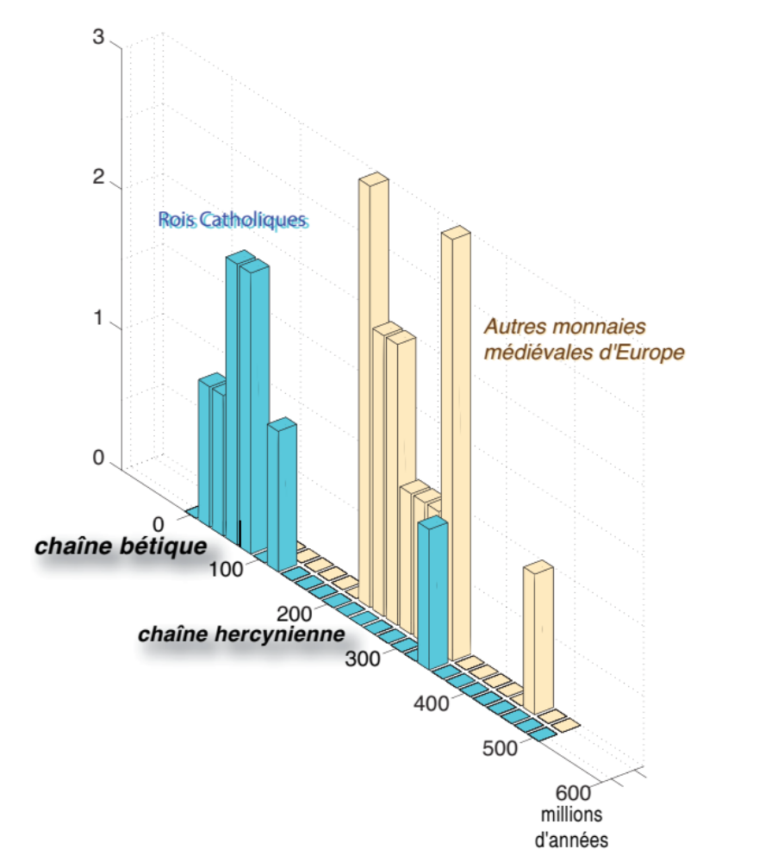
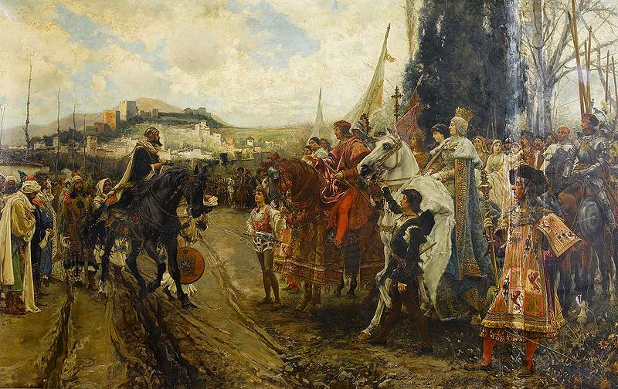
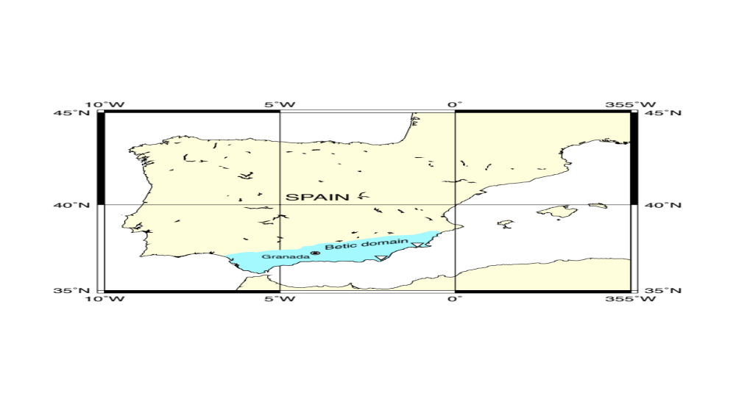
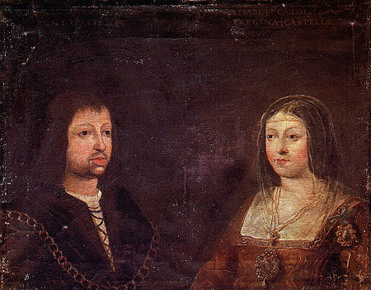
Pb model ages of medieval silver coins
The fall of Granada, or Greed vs Faith
The Reconquista grand finale
The Catholic Kings
Other medieval
silver coins
Isabella of Castile and Ferdinand of Aragon
(The Catholic Kings) (1479-1504 )

Slide 31
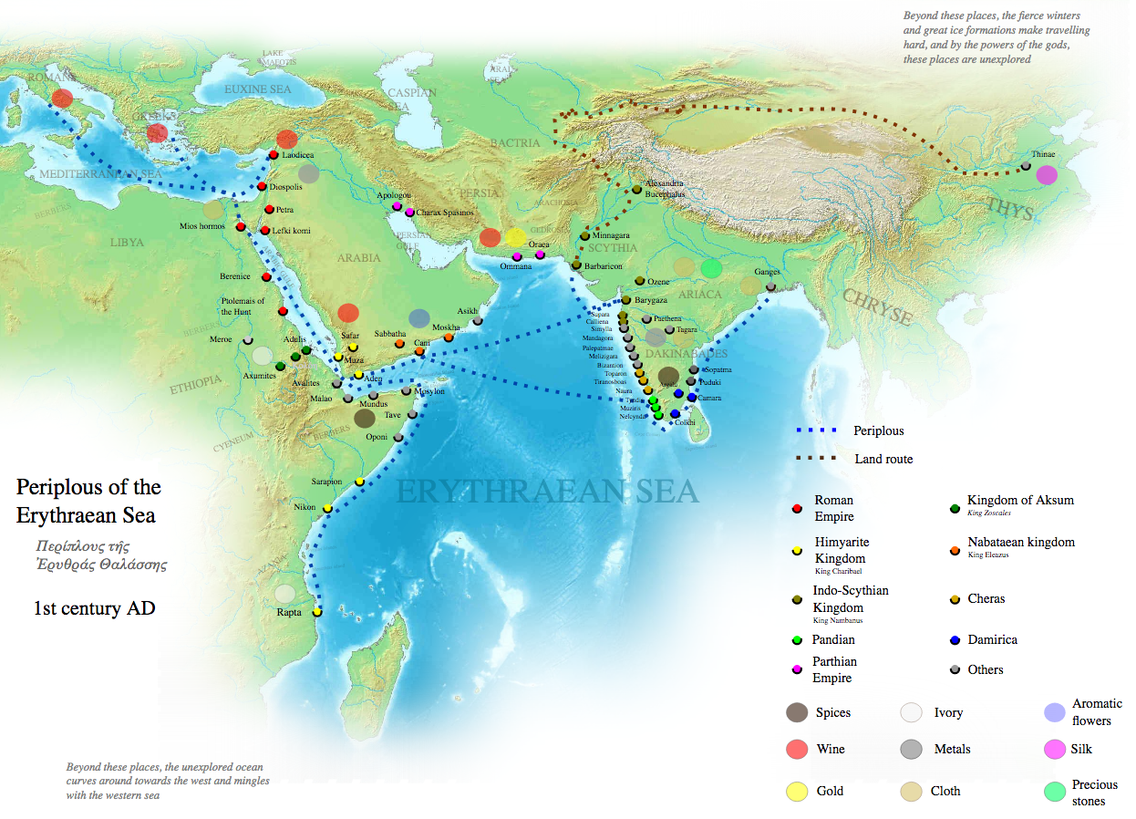
Roman trade in the Indian Ocean in the 1st c. AD

Slide 32
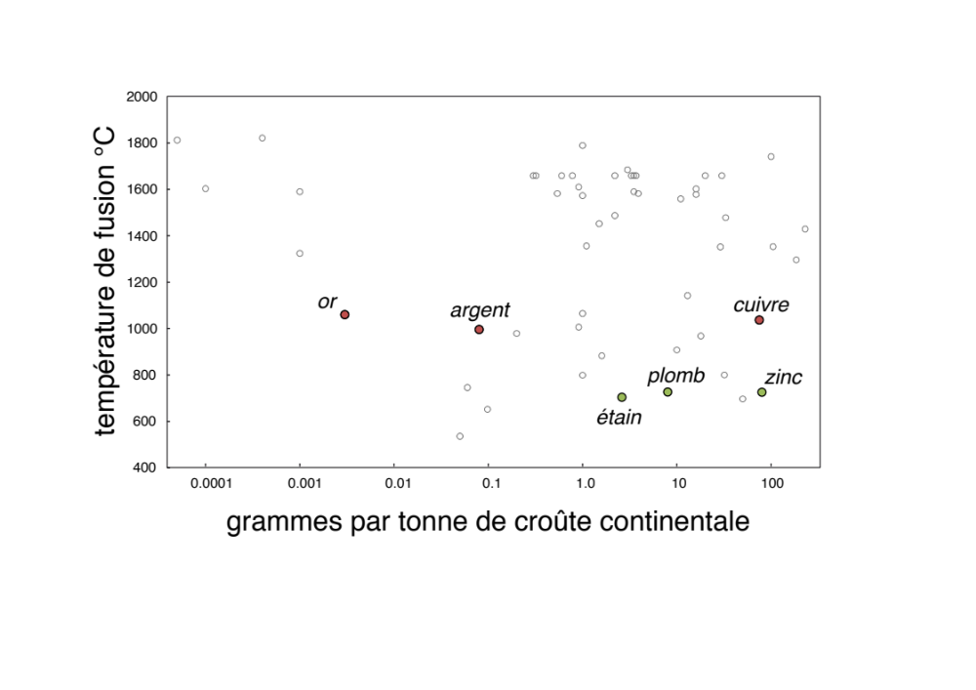
How man opted for coinage metals (Au, Ag, Cu)
too rare
too abundant
too
challenging
melting temperature °C
gold
silver
copper
lead
zinc
too
soft
tin
parts per billion
parts per million in continental crust
Notes:
Pourquoi l’argent? L’argent est une marchandise comme une autre mais il est transportable et non périssable.
L’argent est un troc différé.
L’argent paie des mercenaires, peut être facilement pris, volé, donné.
Sociétés sans argent: peud’activité économique

Slide 34
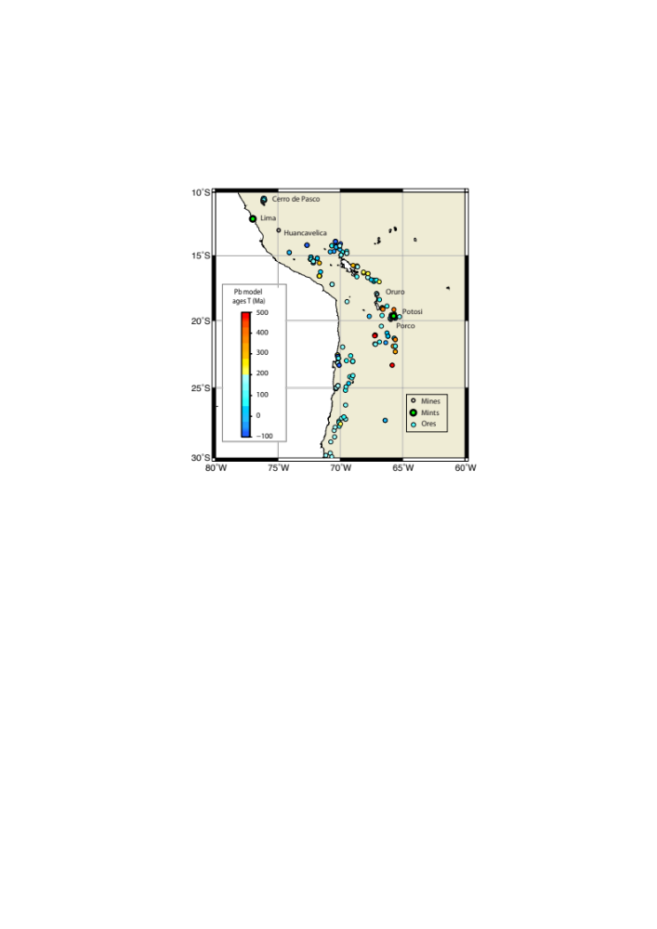
Silver mines and minting in the Spanish Peru (16-18th cent.)
Les âges au plomb fournissent une réponse géologiquement cohérente: les pays Primaires (>250 millions d’années), les granites de la cordillère andine (90-120 Ma), et l’activité volcanique récente.

Slide 35
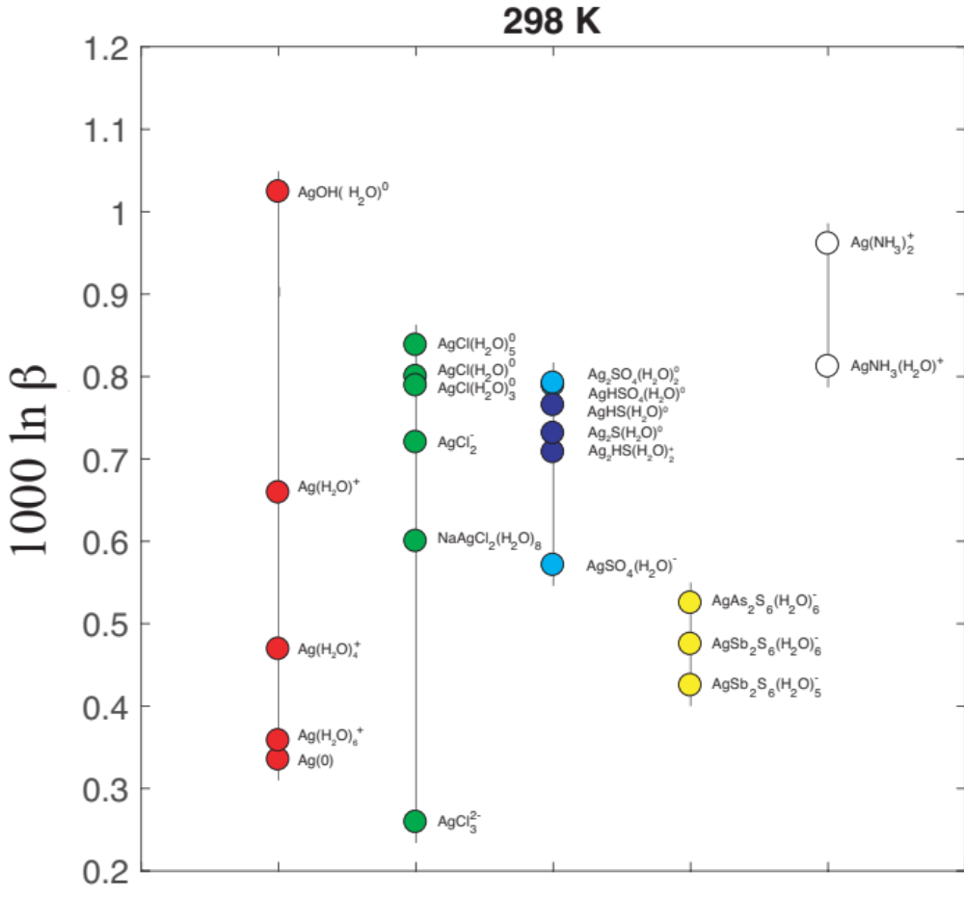
Variations of the ¹⁰⁹Ag/¹⁰⁷Ag ratios among species coexisting in solution at ambient temperatures
Fujii and Albarede,
submitted

