Slide 1
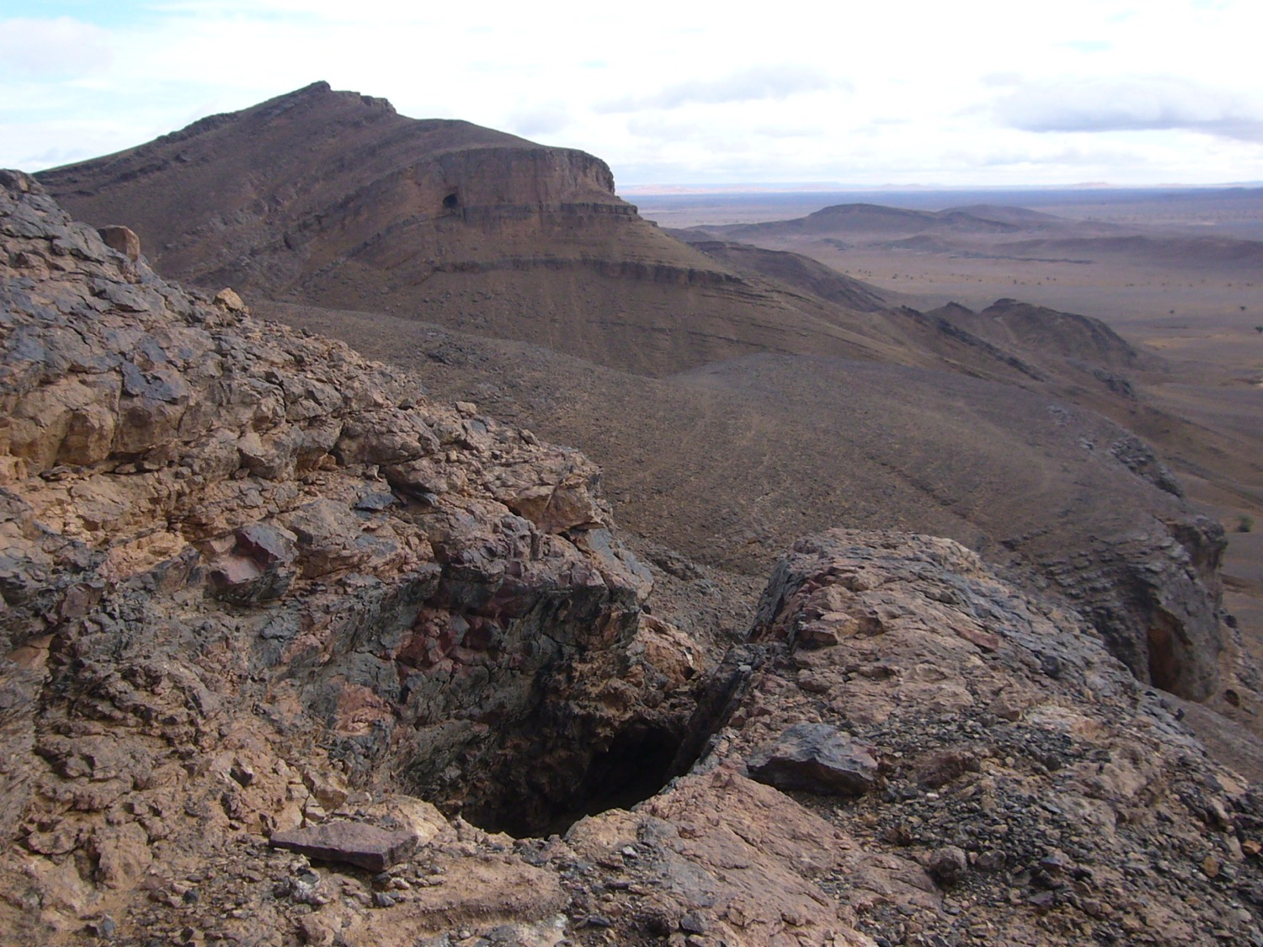

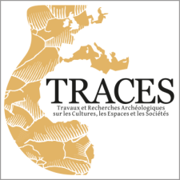

The significance of ore mining districts
and associated metallurgical sites
Sandrine Baron
CNRS, TRACES laboratory, University of Toulouse, France
ERC SILVER Kick-Off Meeting, Lyon, France, January 21-24, 2018

Slide 2
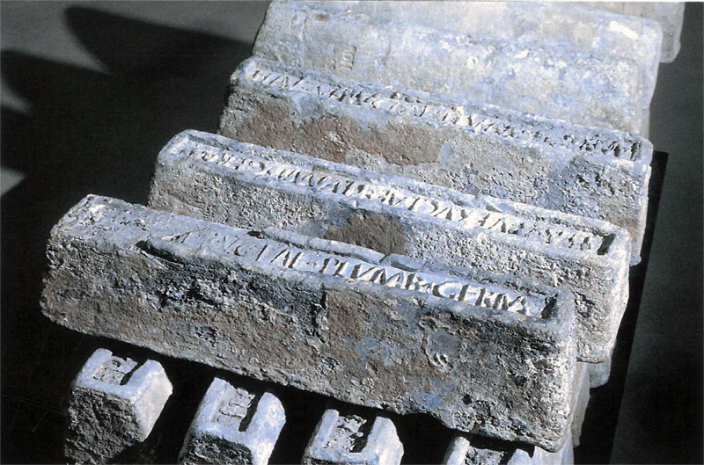
The significance of ore mining districts
and associated metallurgical sites
General background
    Theoretical lead-silver chaîne opératoire
    Theory of metal provenance study
Limiting factors
Strategy
Archaeological examples
    Conclusion : expectations and required work for SILVER

Slide 3
The significance of ore mining districts
and associated metallurgical sites
General background
    Theoretical lead-silver chaîne opératoire
    Theory of metal provenance study
Limiting factors
Strategy
Archaeological examples
    Conclusion : expectations and required work for SILVER

Slide 4
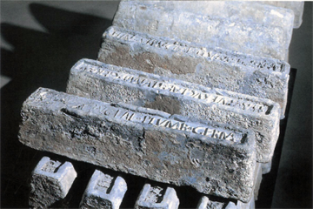
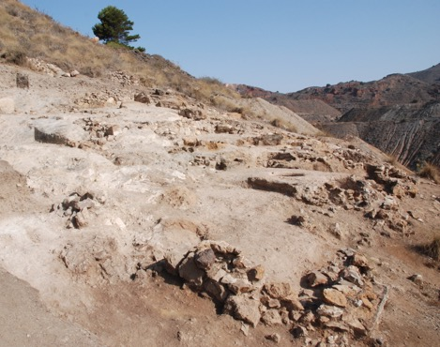
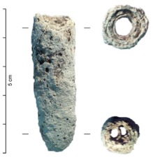
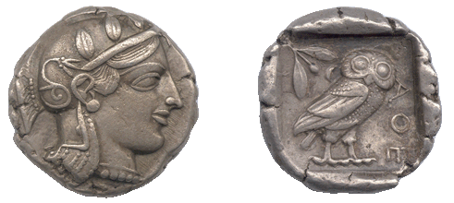
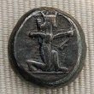
General principle of argentiferous lead chaîne opératoire
Galena ores
S. Baron
Pb ingots (Saintes-Maries-de-la-Mer, France)
Metallurgical process
© Ch. Rico
Merchant lead
Ore treatment structures (Cartagena, Spain)
Lead bullion (Ag rich)
Slags
Reduction
Cupellation
Litharge
Silver ingots
COINS and other precious materials

Slide 5
The significance of ore mining districts
and associated metallurgical sites
General background
    Theoretical lead-silver chaîne opératoire
    Theory of metal provenance study
Limiting factors
Strategy
Archaeological examples
    Conclusion : expectations and required work for SILVER

Slide 6
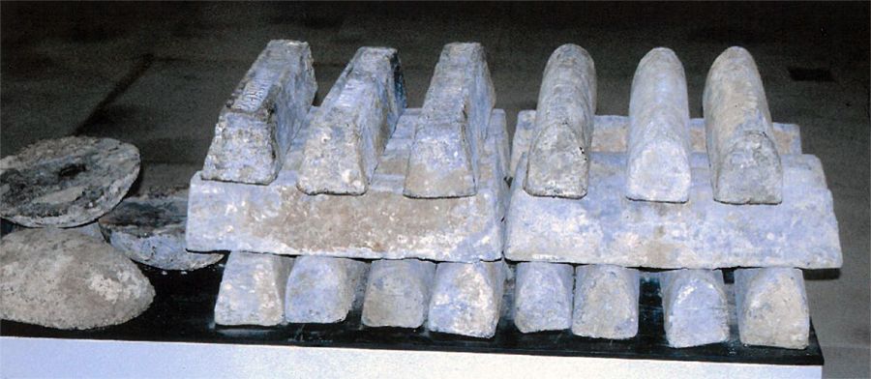
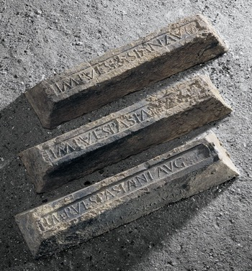
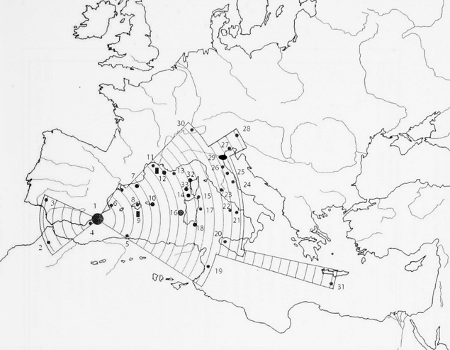
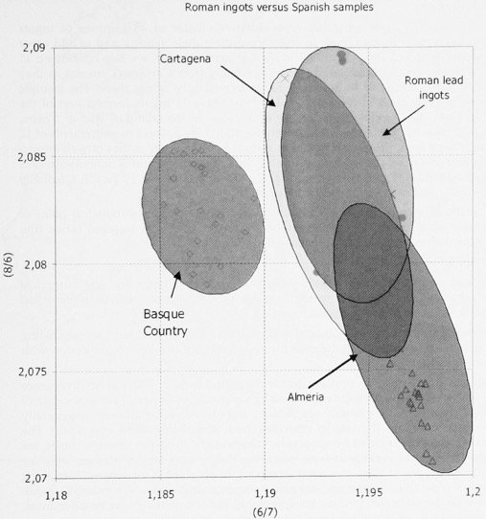
Comparison of isotopic signatures between ores and objects
Example : Trade of lead from Cartagena during Antiquity (Spain)
Roman ingots versus Spanish ores
Cartagena Ores
Lead
ingots
15 cm
Basque Ores
Roman Lead Ingots
(Mediterranean wrecks)
Almeria Ores
Trincherini et al., 2009
Trincherini et al., 2009

Slide 7
Comparison of isotopic signatures between ores and objects
Example : Trade of lead from Cartagena during Antiquity (Spain)
Roman ingots versus Spanish ores
Cartagena Ores
Lead
ingots
Cartagena
15 cm
Basque Ores
Roman Lead Ingots
(Mediterranean wrecks)
Almeria Ores
Trincherini et al., 2009
    To trace the origin of the ores used for manufacturing the metal objects
    To point out the ancient metal trade routes
    (e.g. Budd et al., 1993 ; Stos-Gale et al., 1998 ; Niederschlag et al., 2003 ; Bode et al., 2009)

Slide 8
The significance of ore mining districts
and associated metallurgical sites
General background
    Theoretical lead-silver chaîne opératoire
    Theory of metal provenance study
Limiting factors
Strategy
Archaeological examples
    Conclusion : expectations and required work for SILVER

Slide 9
Three main limiting factors
The mining districts themselves
The metallurgical processes : ores mixing, alloys elaboration, materials additions and recycling
    i.e Chaîne Opératoire
The available isotopic databases
Notes:
Four main factors limits the isotopic tracing : the ores geology though the isotopic signatures of the mining districts themselves (heterogeneity and / or similarities of different ores with different origin) and the lack of relevant ores databases. The second factor is the mixing ores, the alloys and the recycling. The third factor is analytical: the rise of accuracy and precisions of isotopic measurements allowing to more interpreted the data and to rise the isotopic differences. Les résultats d’analyses toujours plus pointues donnent des différences plus importantes car encore plus accentué entre les points analysés. Ce qui implique d’interpréter plus en profondeur ces différences et surtout pas de globaliser sans tenir compte de ces différences importantes. Autrement dit, la représentativité de l’échantillon est au coeur de la question. On ne doit pas analyser un échantillon qui ne représente pas assez la question posée et induira, de fait, des résultats non interprétables.
The fourthly factor is the metallurgical processes where several additions during the ores reduction could be realised … is the technical process operate to optimize the metal recovering.

Slide 10
A last one…
The mining districts themselves
The metallurgical processes : ores mixing, alloys elaboration, materials additions and recycling
    i.e Chaîne Opératoire
The available isotopic databases
The use of MC-ICP-MS which requires a relevant sampling
Notes:
Four main factors limits the isotopic tracing : the ores geology though the isotopic signatures of the mining districts themselves (heterogeneity and / or similarities of different ores with different origin) and the lack of relevant ores databases. The second factor is the mixing ores, the alloys and the recycling. The third factor is analytical: the rise of accuracy and precisions of isotopic measurements allowing to more interpreted the data and to rise the isotopic differences. Les résultats d’analyses toujours plus pointues donnent des différences plus importantes car encore plus accentué entre les points analysés. Ce qui implique d’interpréter plus en profondeur ces différences et surtout pas de globaliser sans tenir compte de ces différences importantes. Autrement dit, la représentativité de l’échantillon est au coeur de la question. On ne doit pas analyser un échantillon qui ne représente pas assez la question posée et induira, de fait, des résultats non interprétables.
The fourthly factor is the metallurgical processes where several additions during the ores reduction could be realised … is the technical process operate to optimize the metal recovering.

Slide 11
Mining districts
Isotopic compositions
  => similarities between several mining districts through Mediterranean world and beyond
  => heterogeneities inside mining district and / or even inside a same lode
Ores selection
=> resources management linked with :
mining rights, coinage laws, ore content, geo political, economical stakes…
mining concessions, different owners (state, private…)
Ores sampling representativeness
        Difficult to recover precisely ore sources

Slide 12
Metallurgical processes : possible disturbance of the tracer
  Additions during chaîne opératoire due to the nature of the exploited ores
  => Optimize the precious metal recovering
  => Favour the slagging formation
Alloys
=> The whole of copper based materials
=> Coins : devaluation by metal additions
Recycling
=> Important for non ferrous metals

Slide 13
The available isotopic databases
Numerous lead isotopic databases exist (e.g. Oxalid)
To reject quickly some geographical areas
To propose some potential sources as metal origin but at too large scale
2. Nevertheless, the available databases have different granularity :
Some of them were established for geological case study
Others are coming from pedestrian prospecting without any archaeological context
Without multi isotopic measurements
Actually, it’s difficult to find THE mine(s) origin

Slide 14
The significance of ore mining districts
and associated metallurgical sites
General background
    Theoretical lead-silver chaîne opératoire
    Theory of metal provenance study
Limiting factors
Strategy
Archaeological examples
    Conclusion : expectations and required work for SILVER

Slide 15
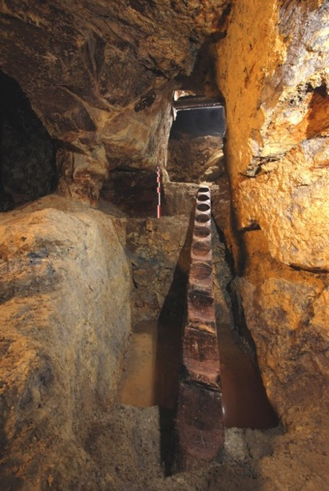
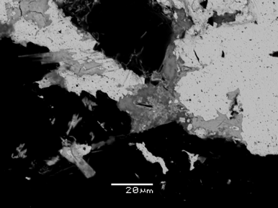
An interdisciplinary research at regional scale
1. Mining Archaeology
dated ores and slags
historical and cultural contexts
Relevant Isotopic
Signature
© C. Tamas
Pb
Ag
© B. Cauuet
Sn
Cu
Fe
…
2. Mineralogy
ore deposition phases
nature of the exploited metal
specific minerals
3. Isotope Geochemistry
signature of a metal production
metallurgical processes understanding
new isotopic tracers development
Set up some isotopic databases which could be considered as referential

Slide 16
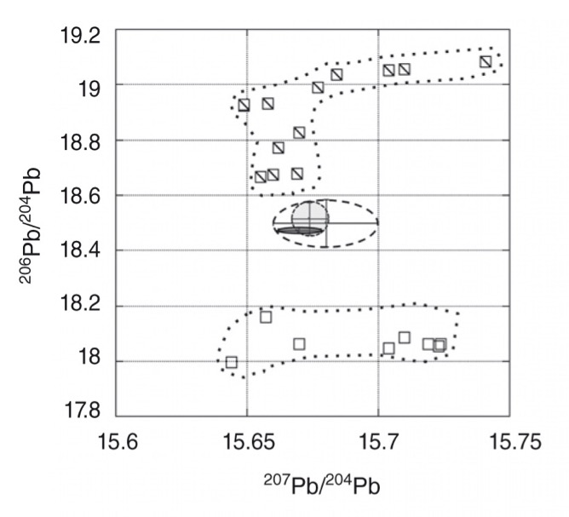
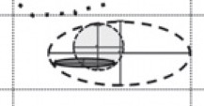
Example of using geological, chronological referenced materials
Example: Silver Production, Medieval Times, South of France
=> Identification of lead signature of produced metal
Ores sampling during pedestrian prospections => NOT Geo-Chrono Referenced materials
Exploited area =
Geo - Chrono referenced materials
Metallurgical wastes = Geo - Chrono referenced materials
Baron et al., 2014
Refine the isotopic tracing
Understand the historical stakes

Slide 17
The significance of ore mining districts
and associated metallurgical sites
General background
    Theoretical lead-silver chaîne opératoire
    Theory of metal provenance study
Limiting factors
Strategy
Archaeological examples
    Conclusion : expectations and required work for SILVER

Slide 18
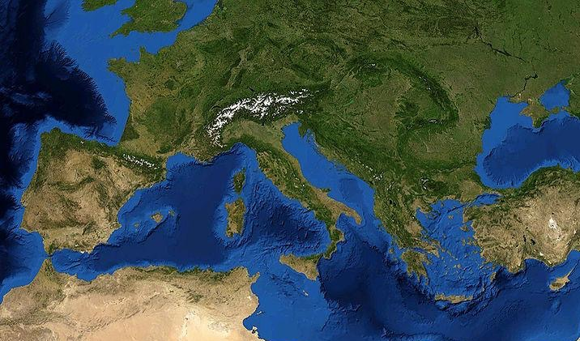
Archaeological examples
Gold-Silver mining district in Gaul
Iron mining district in Narbonne Province
Gold-Silver mining district in Roman Dacia

Slide 19
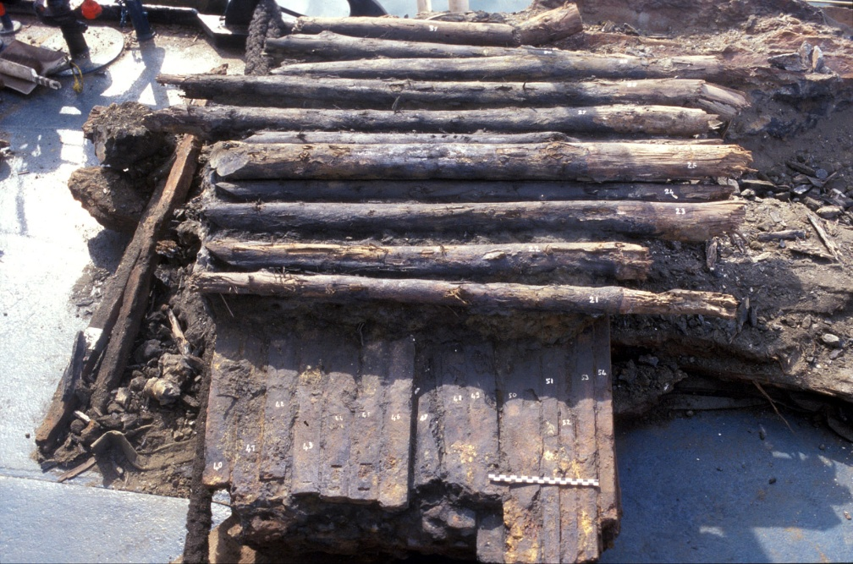
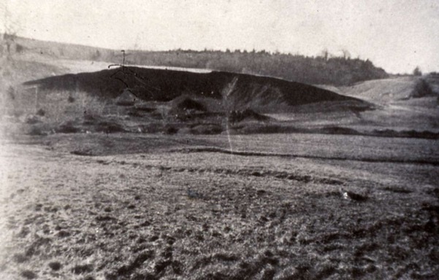
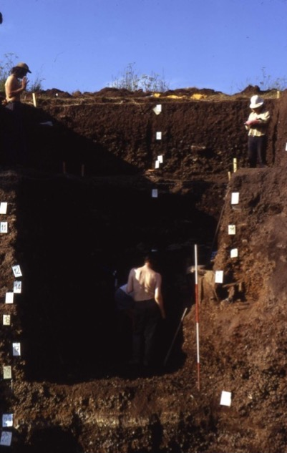
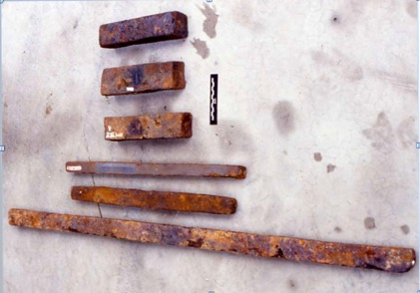
    Iron metal production sites in South of France (1st c. BC to 2nd c. AD)
Montagne Noire mining district
25 m high
20 cm
An iron waste structure in 1935
The « Grand ferrier des Martys »
Excavations 1972-1978
=> 110 000 tons of produced iron for 300 years (Domergue Ed., 1993)

Slide 20
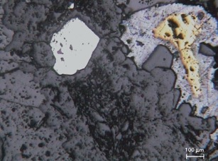
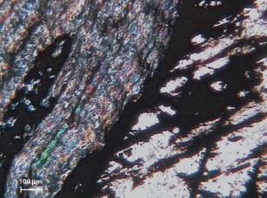
    Iron metal production sites in South of France (1st c. BC to 2nd c. AD)
Montagne Noire mining district hosted two kind of ores
100 μm
Gossan from primary sulfide ore
100 μm
Gossan from primary carbonated ore

Slide 21
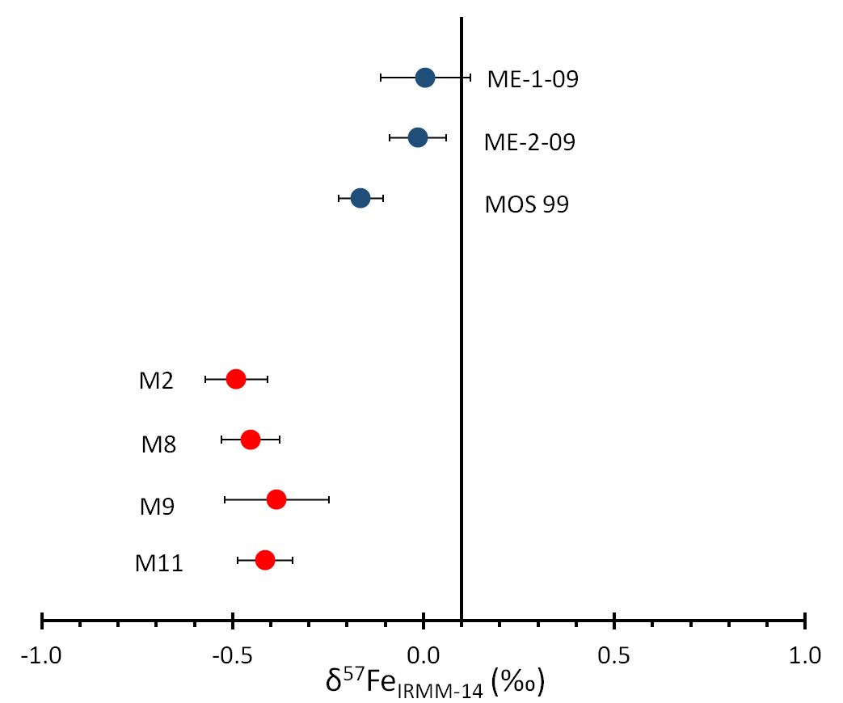
    Iron metal production sites in South of France (1st c. BC to 2nd c. AD)
Montagne Noire mining district hosted two kind of ores
Gossan from primary
sulfide ores
100 μm
Gossan from primary sulfide ore
Gossan from primary carbonated ores
100 μm
Gossan from primary carbonated ore
(Milot et al., 2016)
=> Refining the traceability thanks to the use of ores exploited by ancient miners

Slide 22
    Gold – silver production during Celtic period in France (6th to 3rd c. BC)
(Cauuet, 1999 ; 2005)
A minimum of 74 tons of produced gold

Slide 23
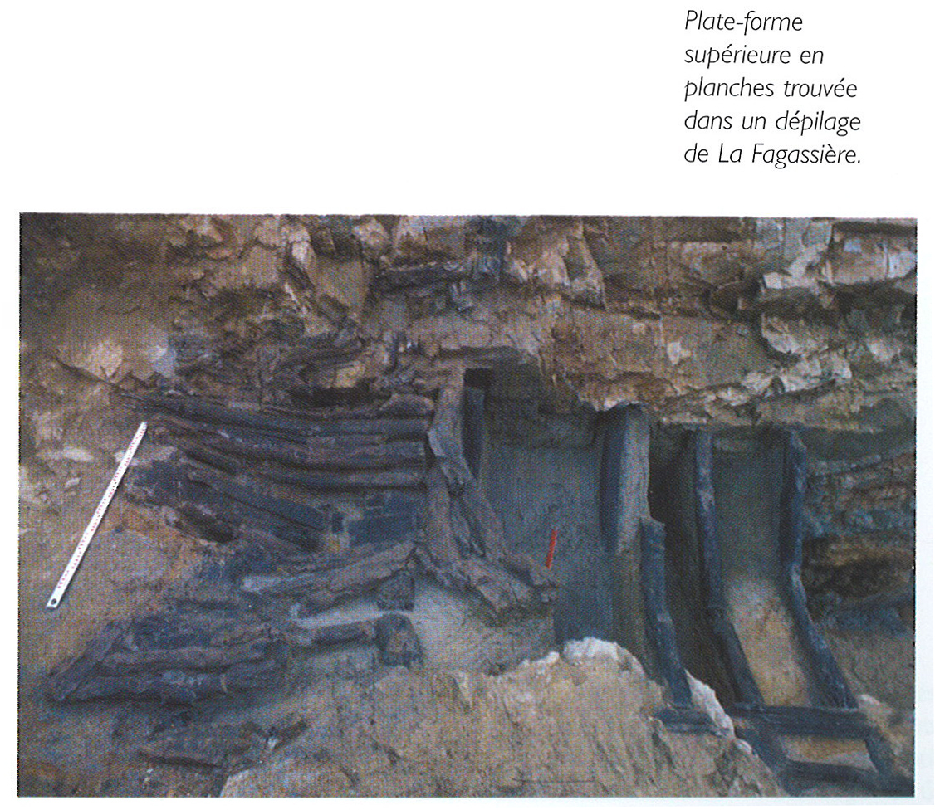
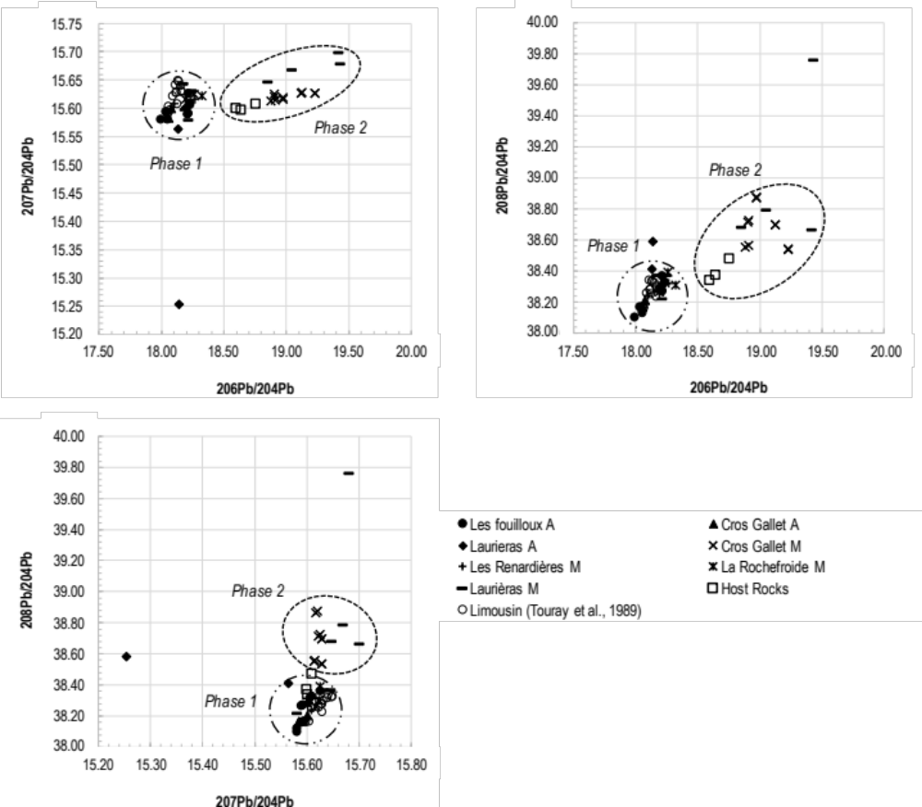
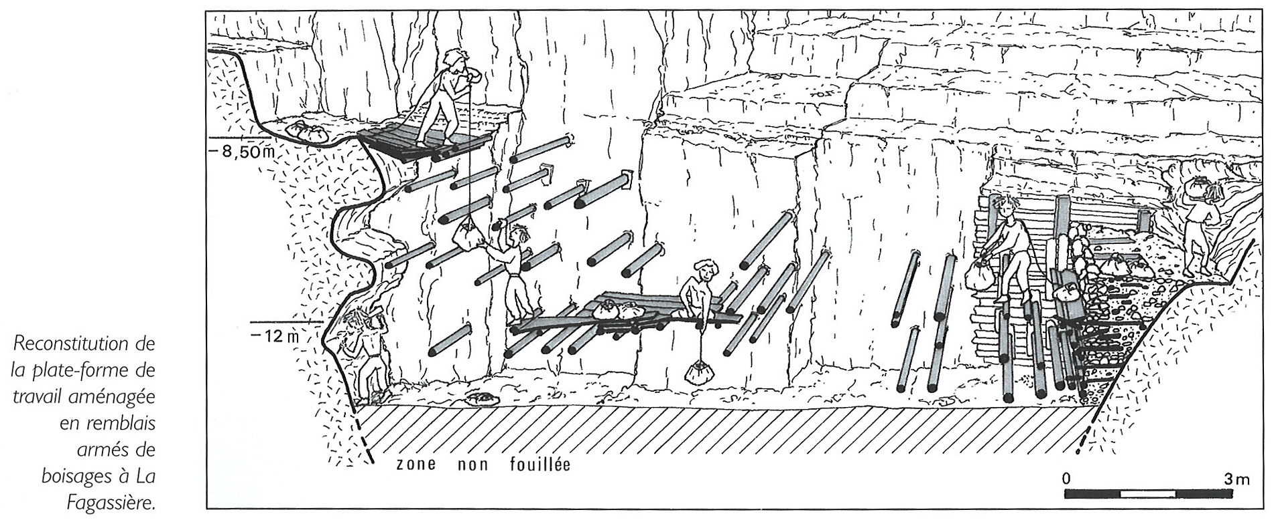
    Gold – silver production during Celtic period in France (6th to 3rd c. BC)
(Cauuet, 2005)
(Baron et al., in prep)
Phase 1 : ores exploited by ancient miners (the richest ores in gold and silver)
Phase 2 : ores not exploited by ancient miners
=> narrow the isotopic signature of
production
(Cauuet, 2005)

Slide 24
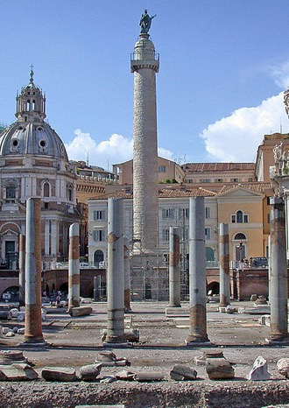
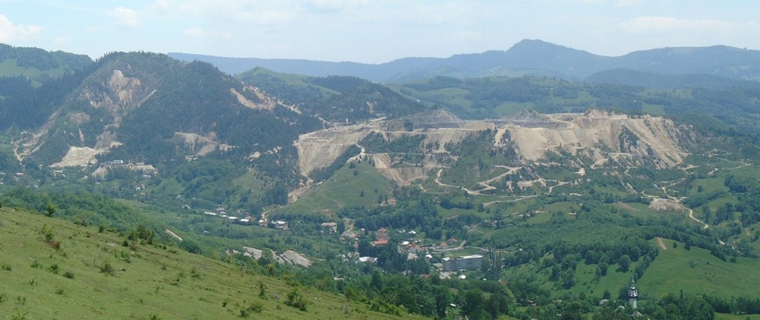
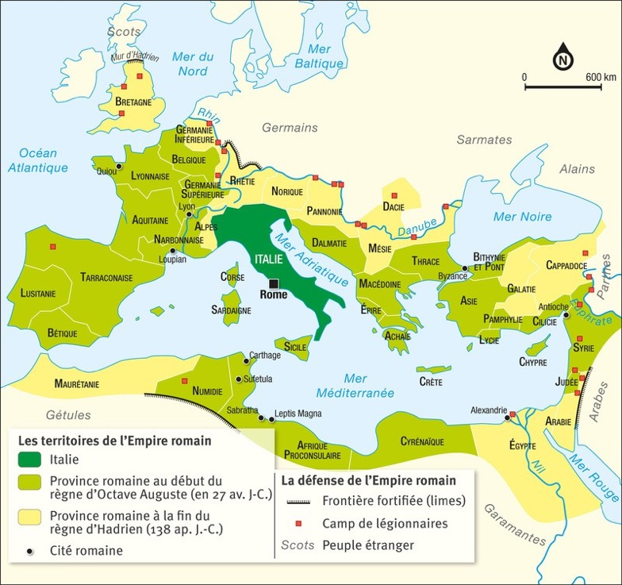
    Gold – silver production in Roman Dacia (1st to 2nd c. AD)
In 107 AD: apogee of Roman Empire
Trajan’s column, Rome
=> Praise of Dacia conquest
Dacia conquest was a real stake :
motivated by ores resources exploitation to hold the empire frontiers
Dacia conquest was decisive for roman economy i.e. 165 tons of gold and 331 tons of silver,
50 000 warriors, numerous gold and silver tableware…(Lydus, De Magistratibus, II, 28)

Slide 25
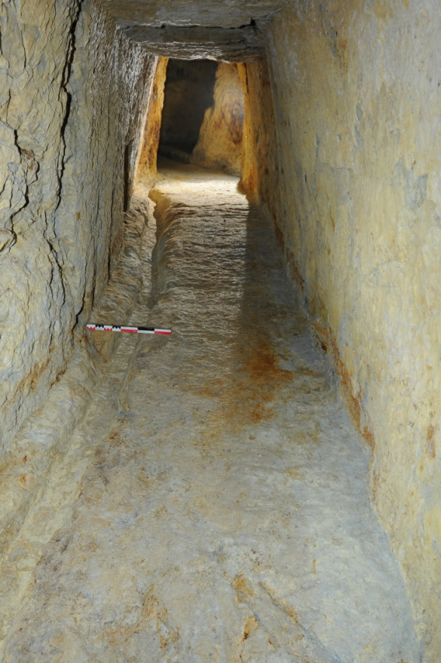
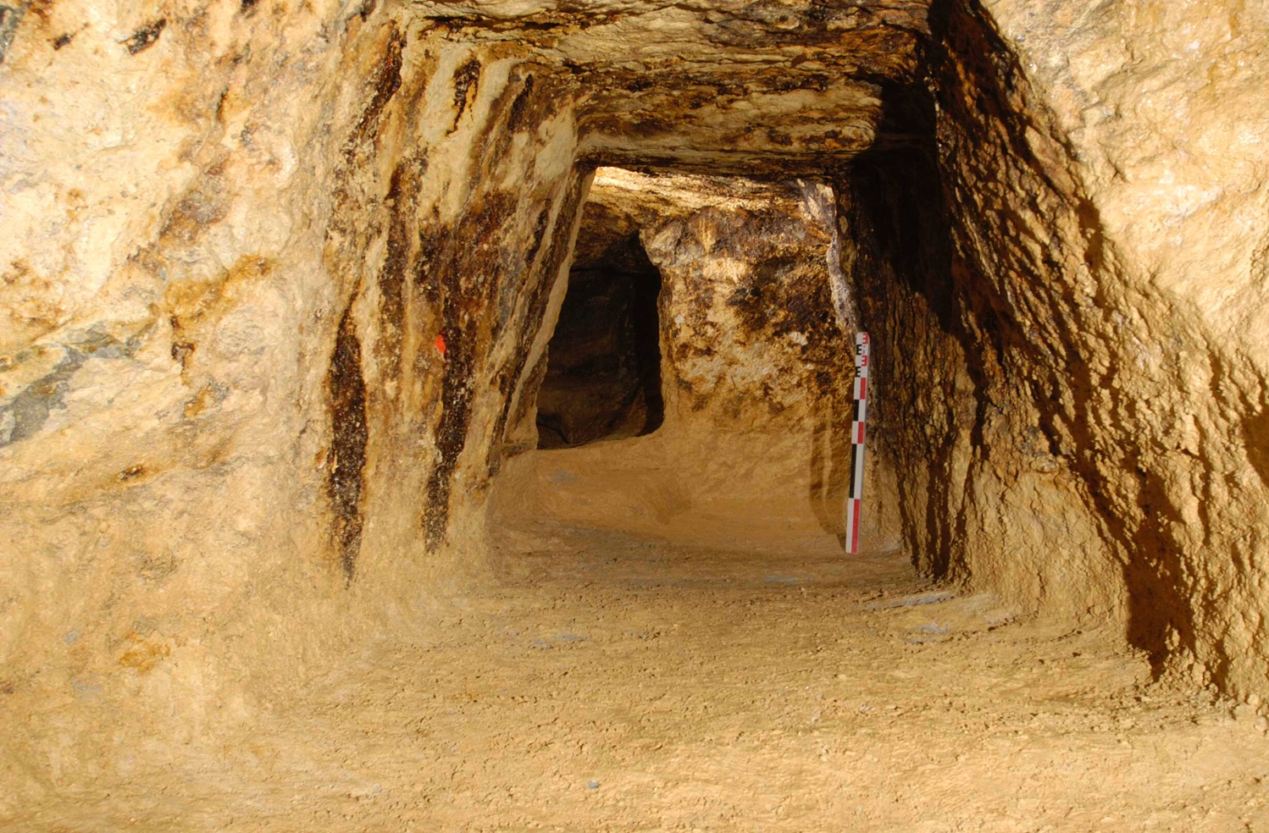

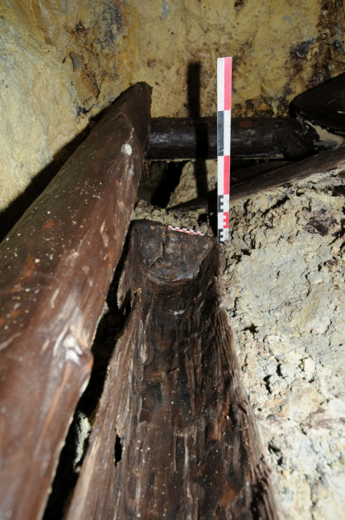
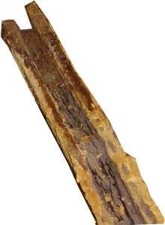
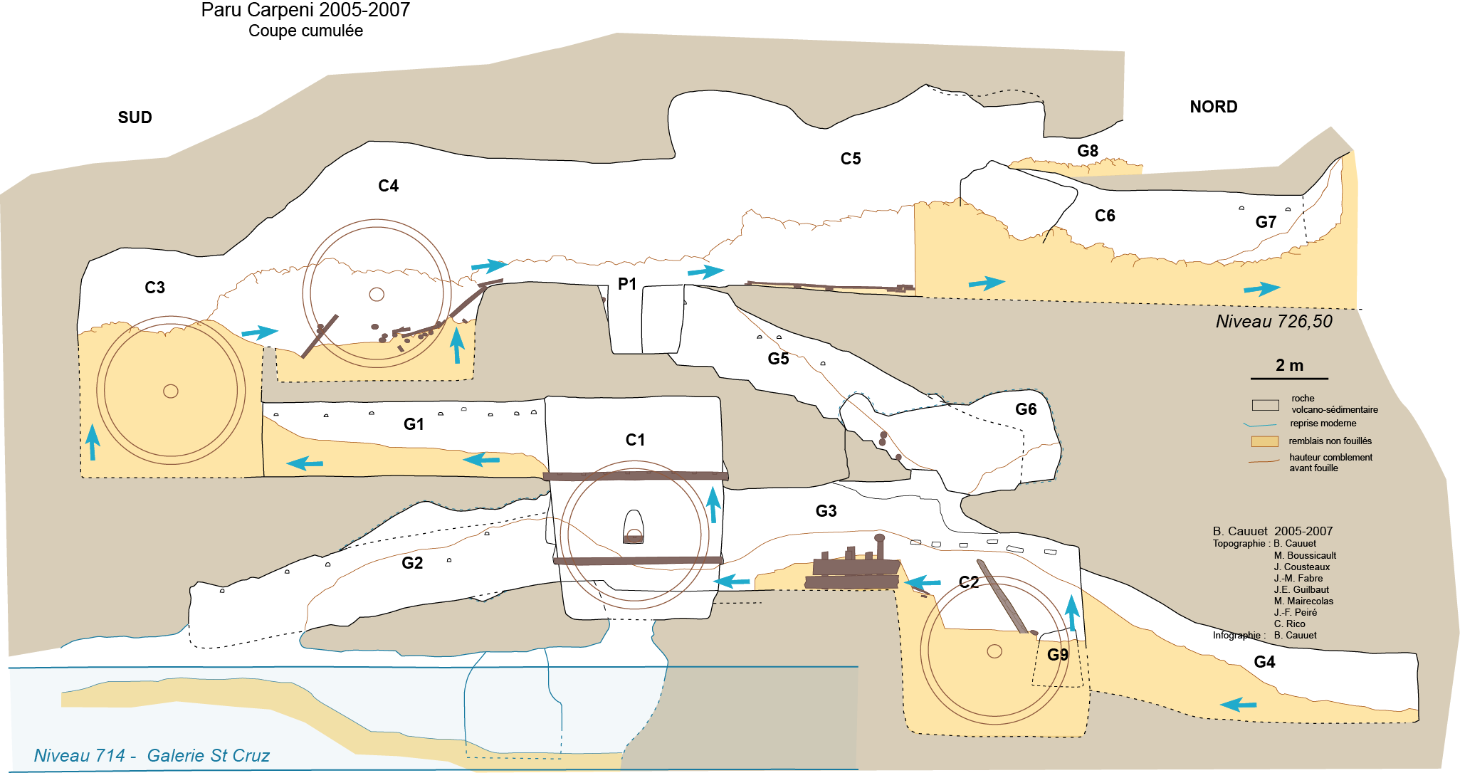
    Rosia Montana mining district
© B. Cauuet
- 6 Km long excavated galleries
- Discovering of numerous hydraulic systems
and ores treatment structures
© B. Cauuet
Cauuet, 2012

Slide 26
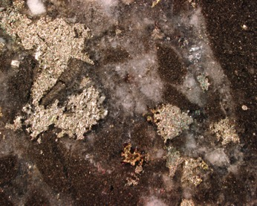
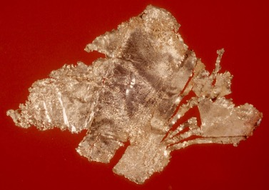
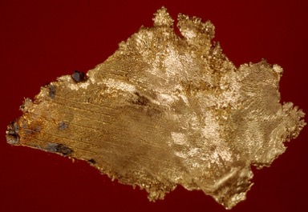
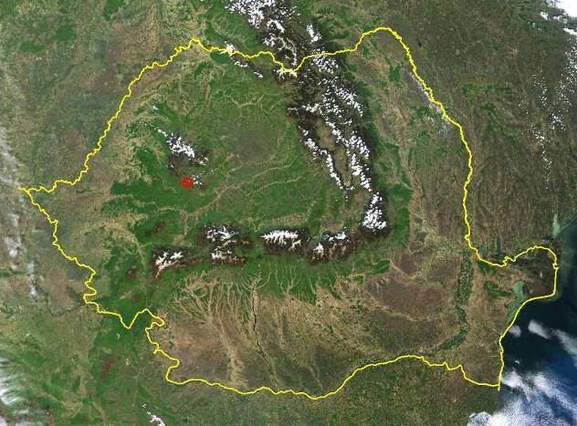
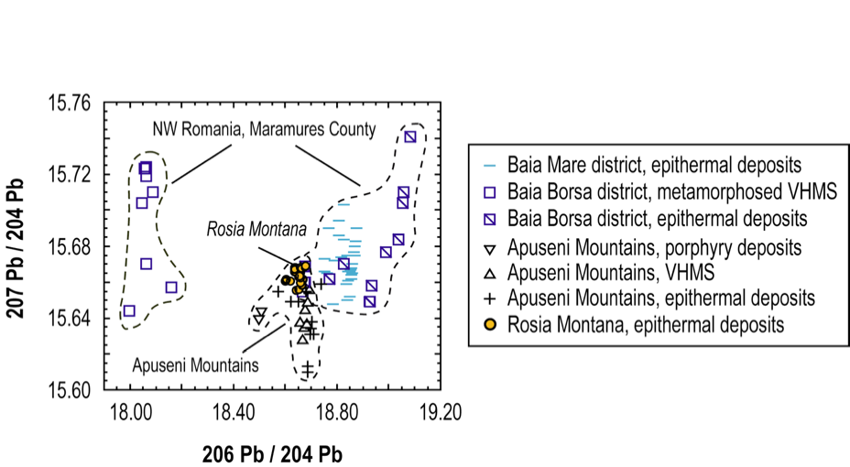
    Isotopic composition of Rosia Montana gold-silver ores
Ores => Electrum, Ag > Au
0,1 mm
Baia Mare mining district
Cluj-Napoca
Gold Museum, Brad, Romania (4 cm long, photo G. Lehrberger)
RM mining district
Bucharest
Baron et al., 2011

Slide 27
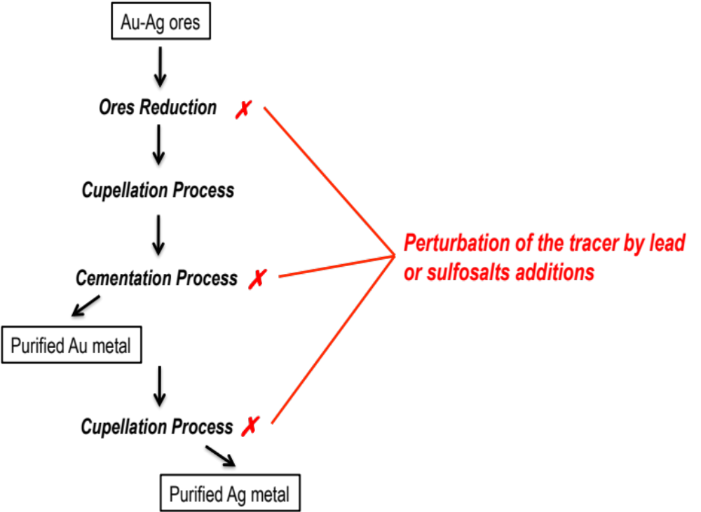
    Gold – silver chaîne opératoire in Rosia Montana (1st to 2nd c. AD)
Ores do not contain enough Pb to set up a Au-Ag chaîne opératoire
Lead additions => metal and/ or sulfosalts
=> Possible disturbance of the tracer
(Backmann, 1995, Domergue 2008)

Slide 28
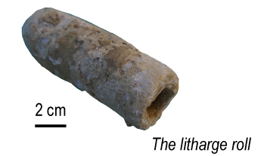
    Gold – silver chaîne opératoire in Rosia Montana (1st to 2nd c. AD)
Pb addition during the metallurgical process

Slide 29
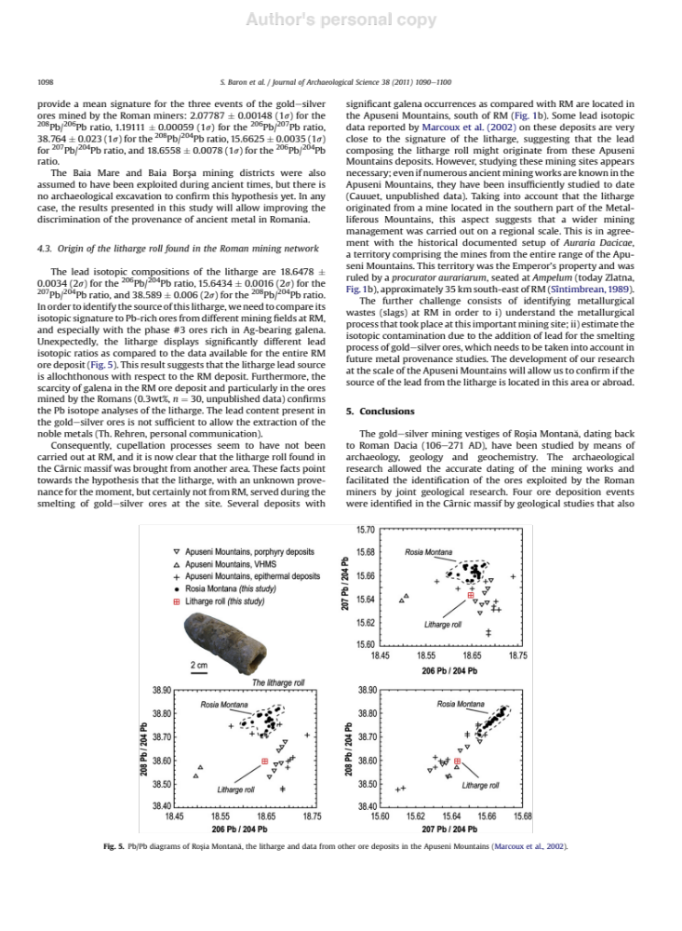
    Gold – silver chaîne opératoire in Rosia Montana (1st to 2nd c. AD)
=> Pb importation from other sources
Litharge trade is usual
Evidence in Spain
(e.g. Renzi et al., 2009 ; Murillo-Barroso et al., 2016)
Baron et al., 2011
In Rio Tinto mines (Spain), some Pb from Cartagena were imported to extract Ag from ores

Slide 30
The significance of ore mining districts
and associated metallurgical sites
General background
    Theoretical lead-silver chaîne opératoire
    Theory of metal provenance study
Limiting factors
Strategy
Archaeological examples
    Conclusion : expectations and required work for SILVER

Slide 31
    My expectations for SILVER project
Re evaluate all ores databases by sorting them through geology, archaeological context and isotopic data (e.g. absence of ²⁰⁴Pb, presence of other isotopic measurements…)
Highlight mining regions underestimated as metal sources
Update the existing databases by acquisition of new samples and new isotopic data on unexplored or few documented mining districts / mines (Laurion…)
Investigate polymetallic ores treatments for silver production
Focus on ores and slags in archaeological context (acquisitions of samples from old excavations stored in museums or institutes and/or from excavations in progress…)
More generally, my expectations are
Estimate silver metal fluxes per mining district / mine(s) through history
Learn from others disciplines
Provide relevant referential to the community working on provenance studies

Slide 32
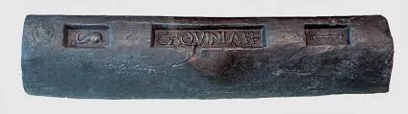
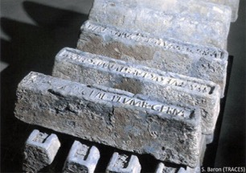
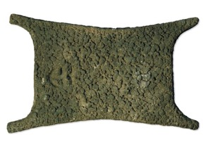
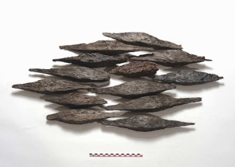
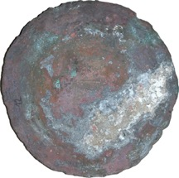
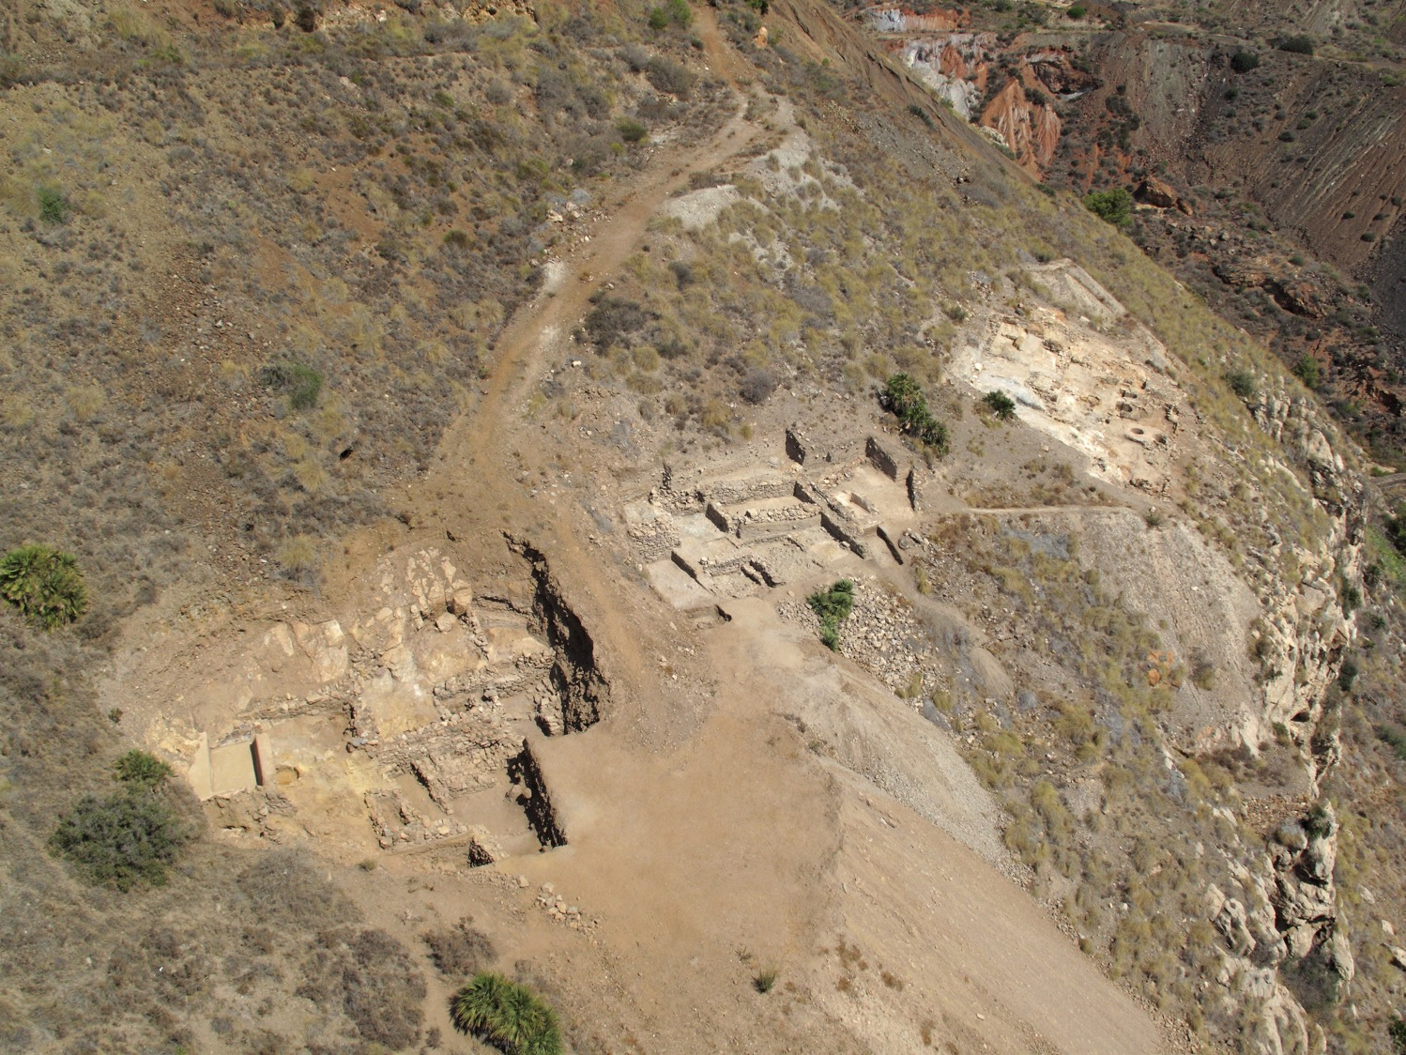
Thank you for your attention
© Ch. Rico (Cartagena, Spain)

